Slide 1
Introduction to Aerospace Engineering
Classification of Aerospace Vehicles

Slide 2
Contents
Introduction - classification of aerospace vehicles
Aerostats
Aerodynes
Ground-effect crafts
Fixed Wing Aircraft
General Description
Fuselage
Wings
Rotorcraft

Slide 3
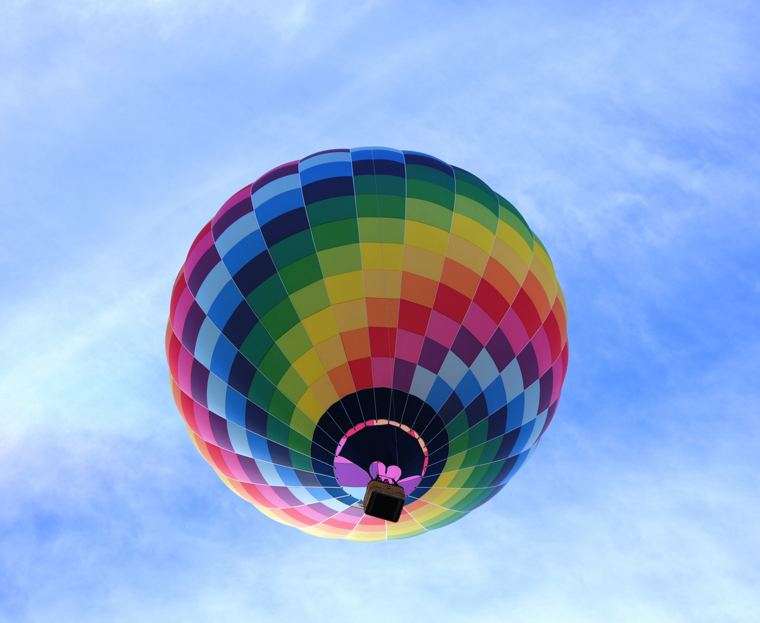
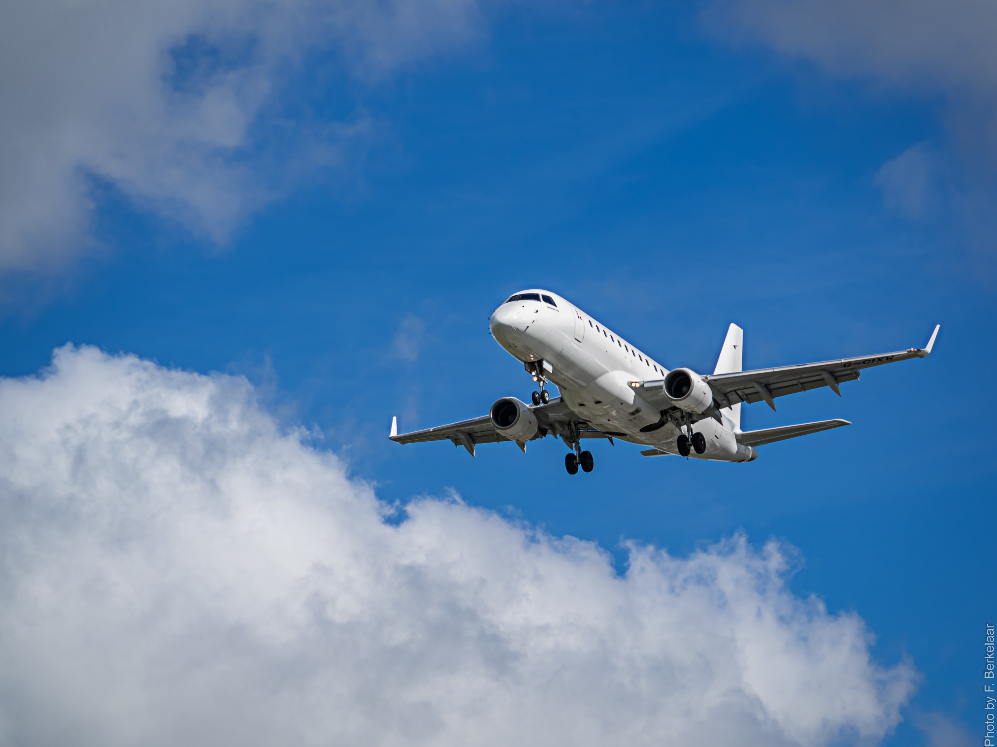
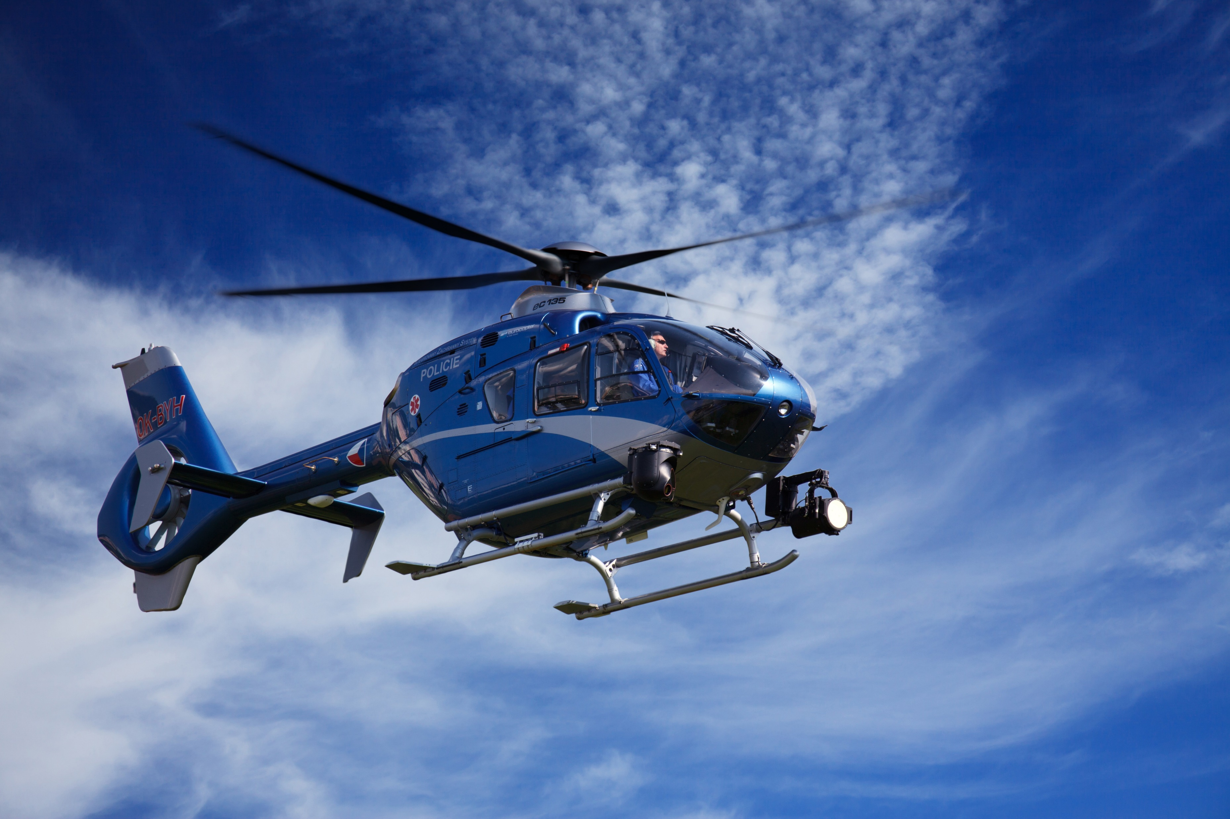
Clasification of air vehicles
Aerostats
Aerodynes
Lift is generated using a gas than is lighter than air.
Lift is generated through dynamic effects on the fluid in the vicinity of the craft.
C2 - Confidential
Notes:
An aircraft, in a wide sense, is a vehicle capable to navigate in the air (in general, in the atmosphere of a planet) by means of a lift force. This lift appears due to two different physical phenomena:
• aerostatic lift, which gives name to the aerostats (lighter than the air vehicles), and
• dynamic effects generating lift forces, which gives name to the aerodynes (heavier
than the air vehicles).

Slide 4
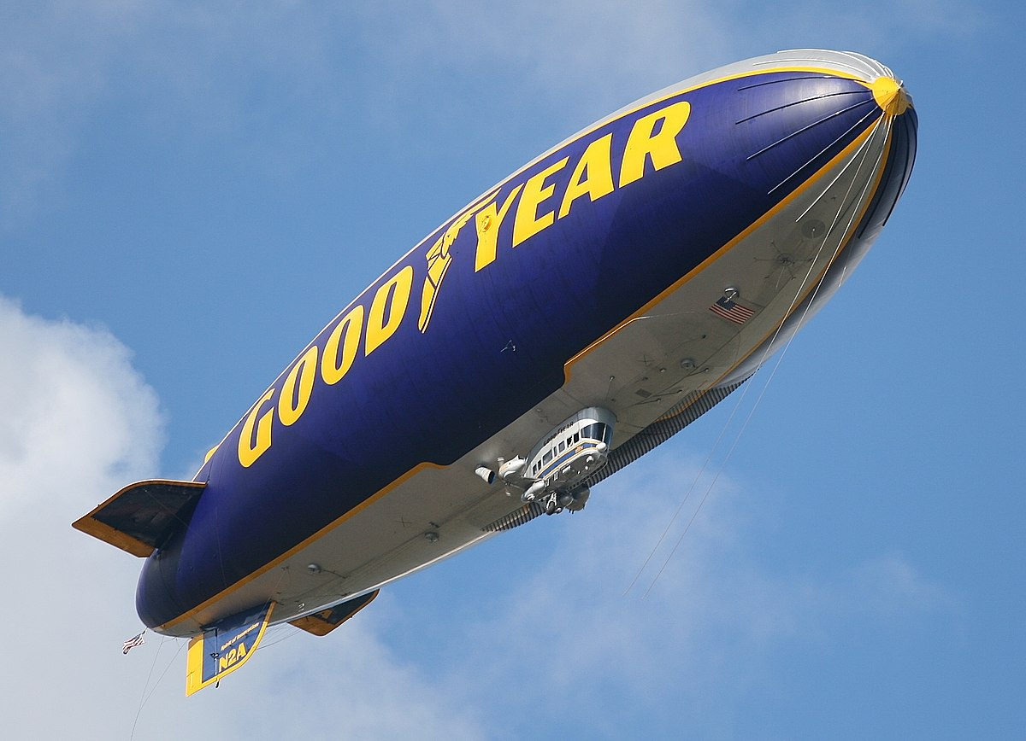
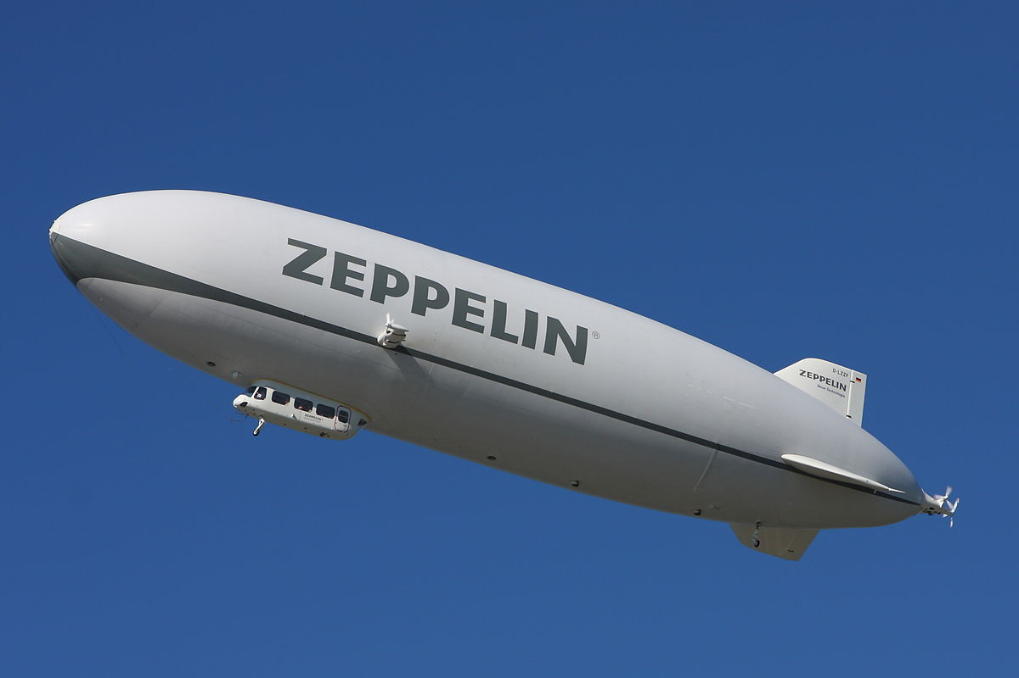
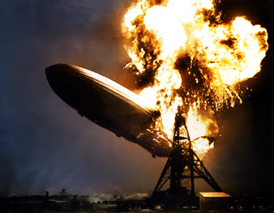
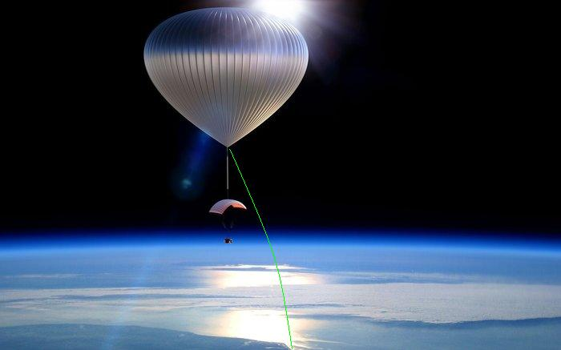
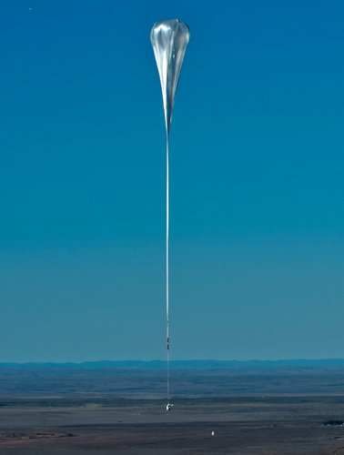
Clasification of air vehicles
Aerostats
Airships
Have a powerplant, control and direction systems.
Aerostatic Balloons
Move freely in the air and the flight control is limited by the atmospheric streams.
C2 - Confidential
Notes:
An aerostat is a craft that remains aloft primarily using lighter than air gases, which produce lift to the vehicle with nearly the same overall density as air. Aerostats include airships and aerostatic balloons. Aerostats stay aloft by having a large "envelope" filled with a gas which is less dense than the surrounding atmosphere.

Slide 5

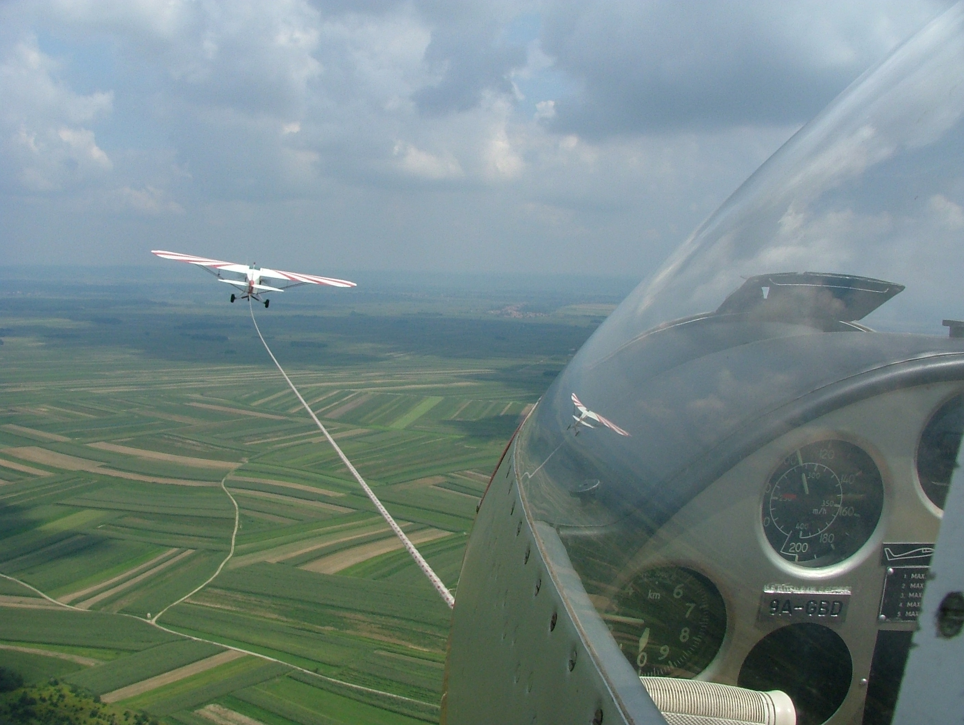
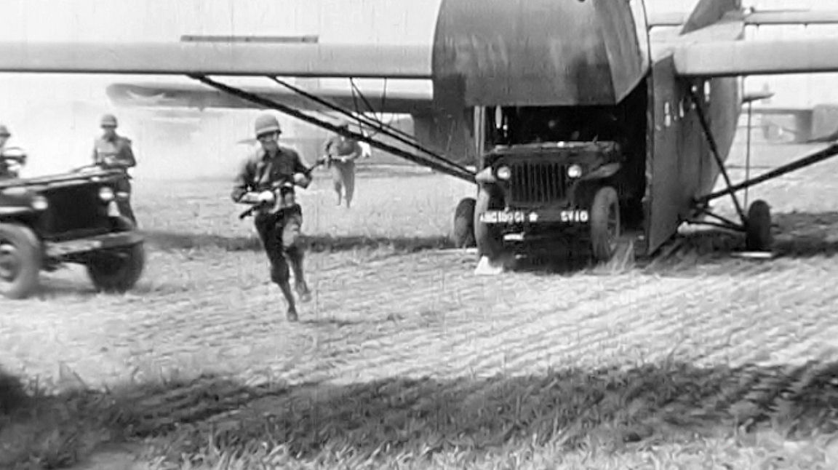
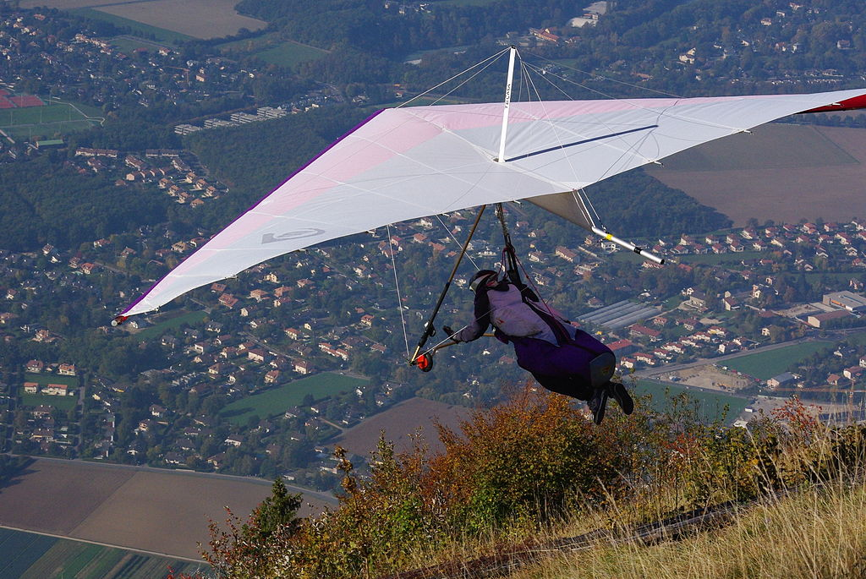

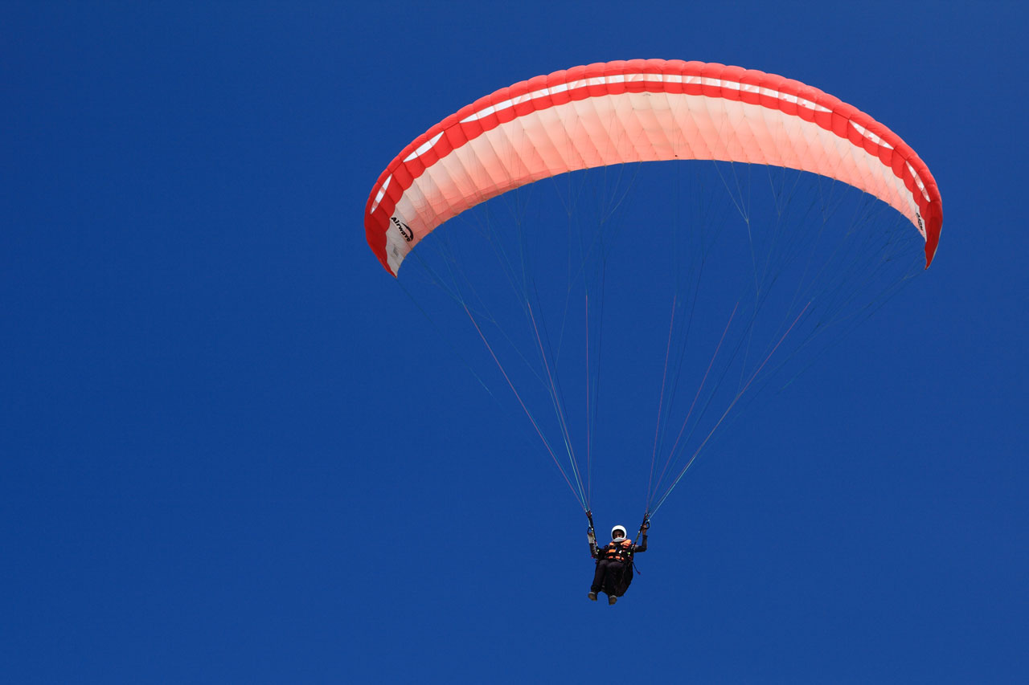
Clasification of air vehicles
Aerodynes without powerplant
Gliders
Need an initial push. High-performance models.
Paragliders
Controlled by synchronizing the orientation of the hand glider.
Esta foto de Autor desconocido está bajo licencia CC BY-SA
C2 - Confidential
Notes:
A first division arises if we distinguish those aerodynes with engines from those without engines.
A glider is an aircraft whose flight does not depend on an engine. The most common varieties use the component of their weight to descent while they exploit meteorological phenomena (such thermal gradients and wind deflections) to maintain or even gain height. Other gliders use a tow powered aircraft to ascent. Gliders are principally used for the air sports of gliding, hang gliding and paragliding, or simply as leisure time for private pilots.
Paragliders and delta wings are distinguished from the glider because the control of this type of aircraft is done by synchronizing the movements of the pilot with controls that act directly on the orientation of the hang glider or paraglider wing.

Slide 6
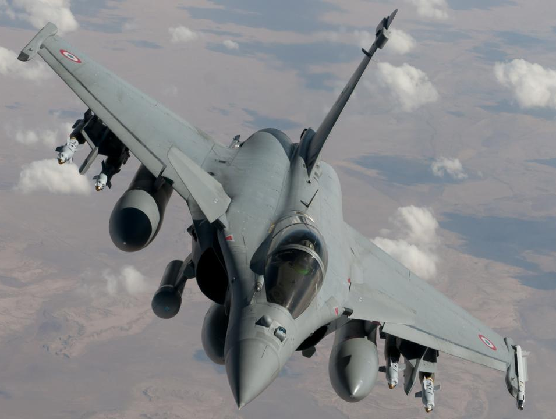
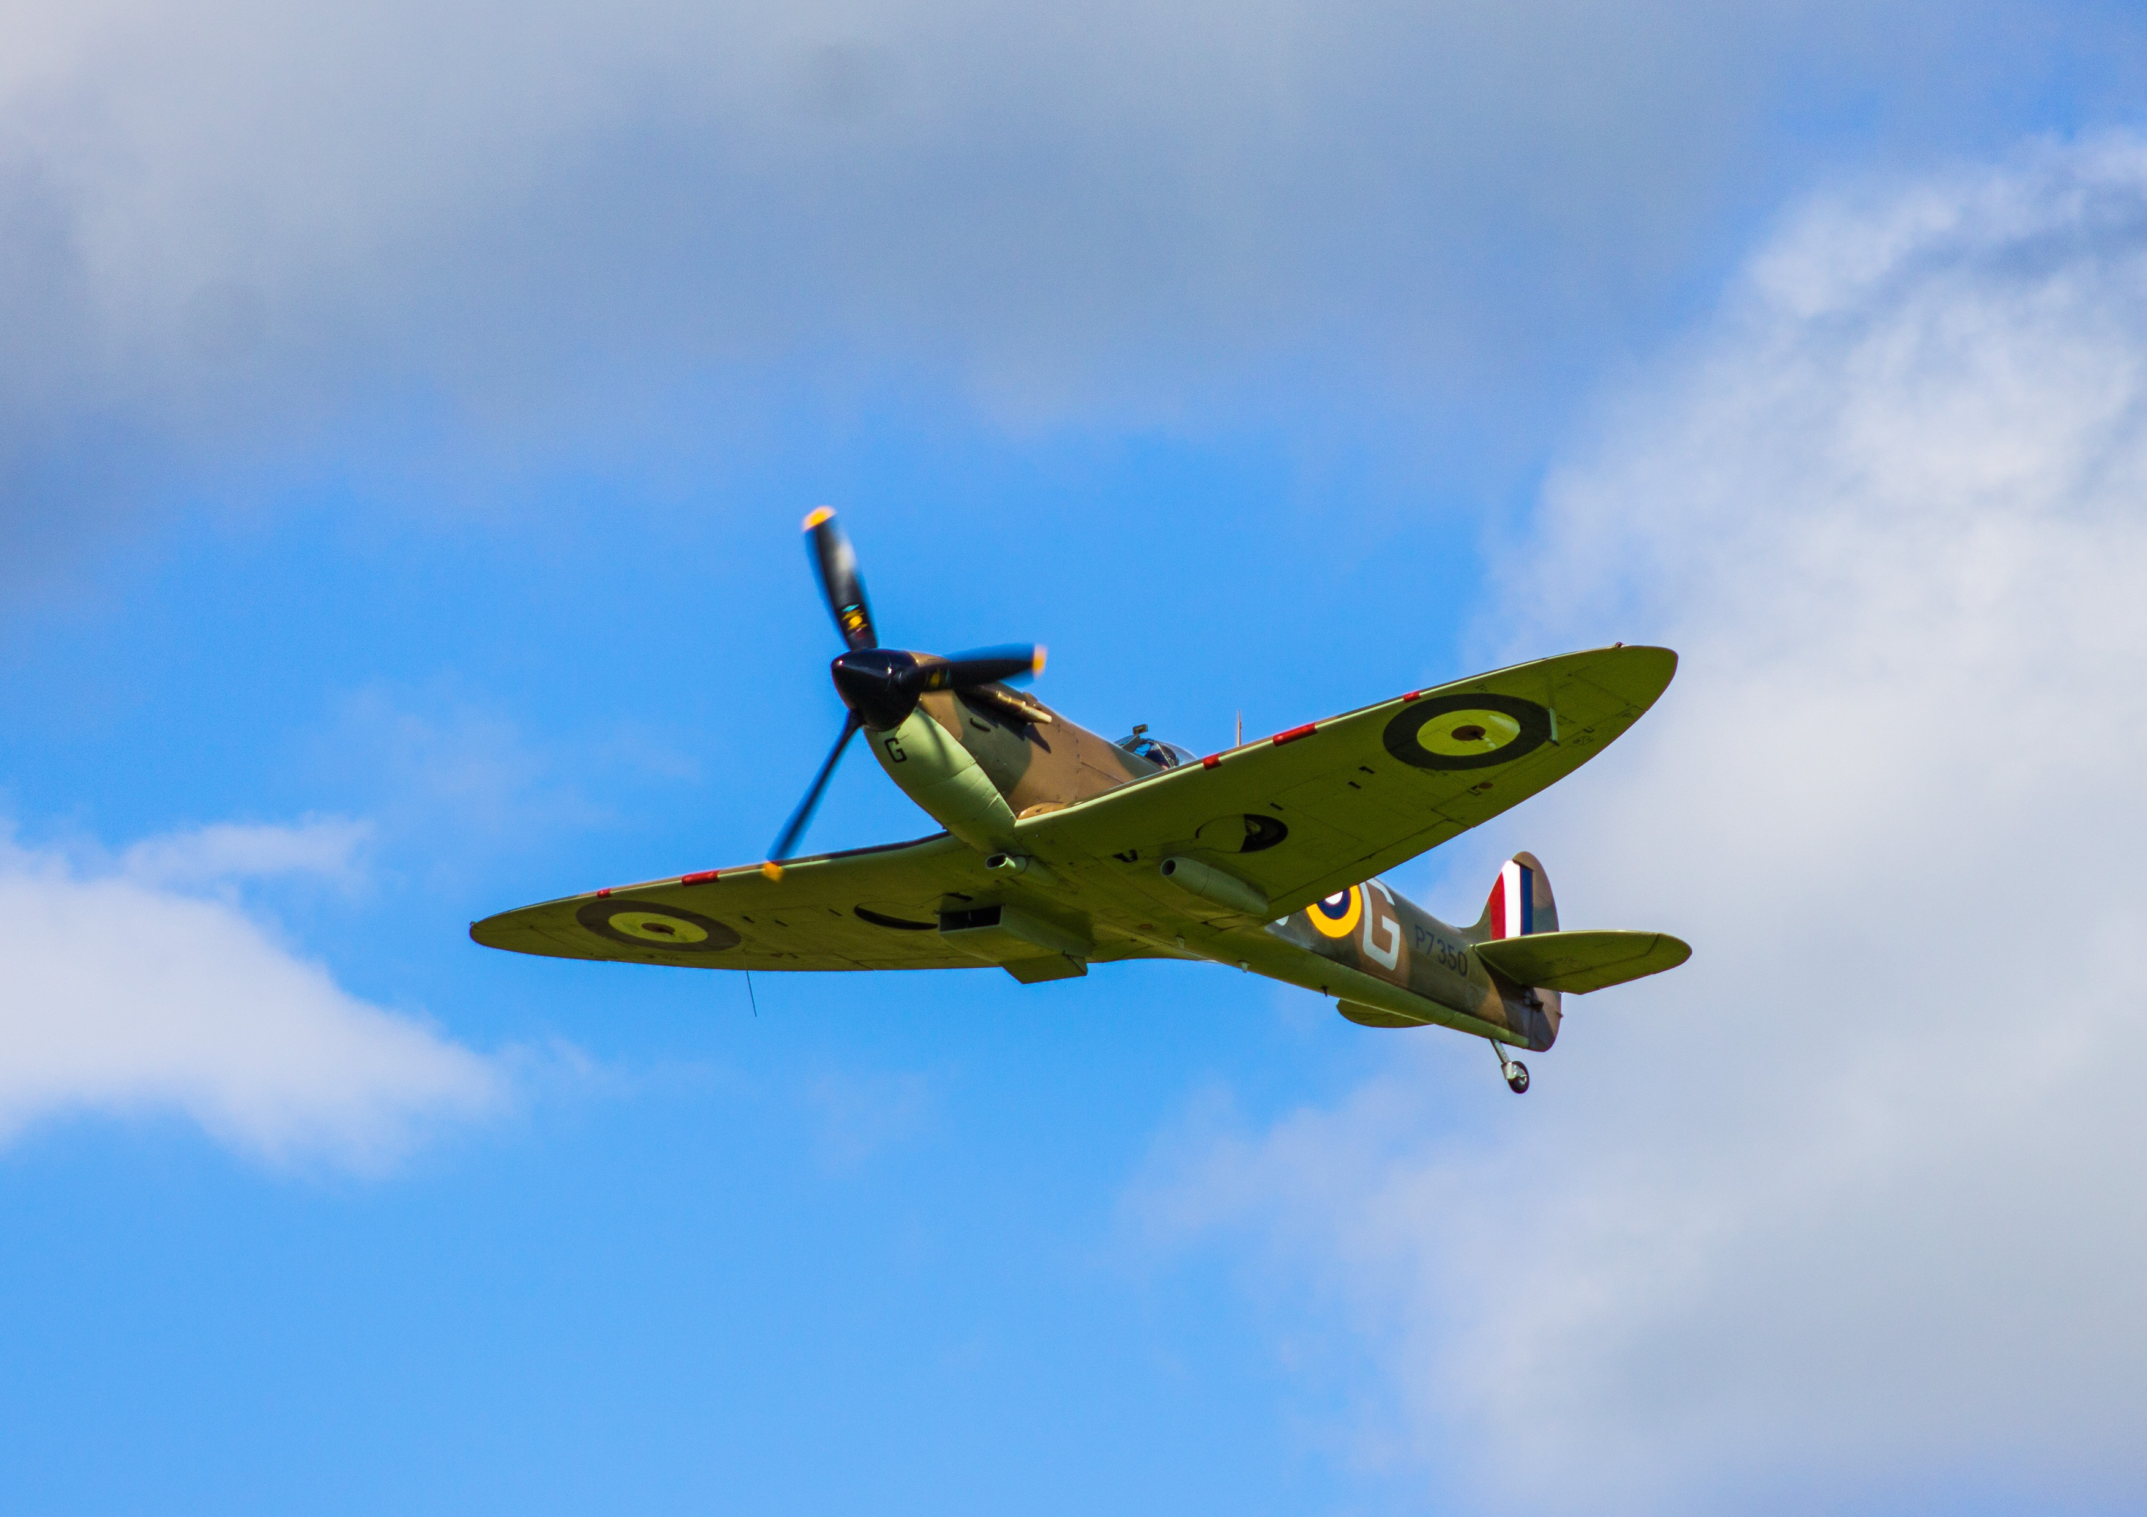
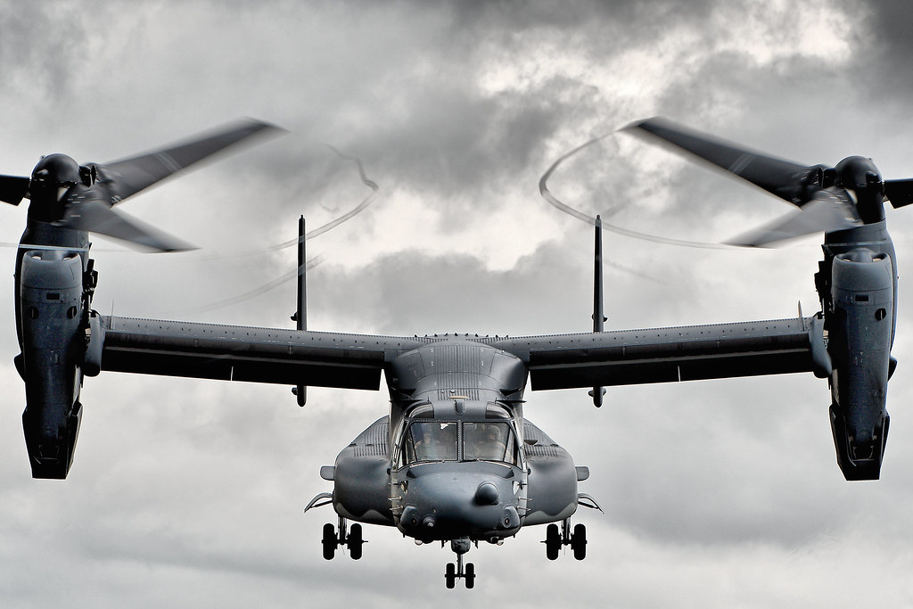
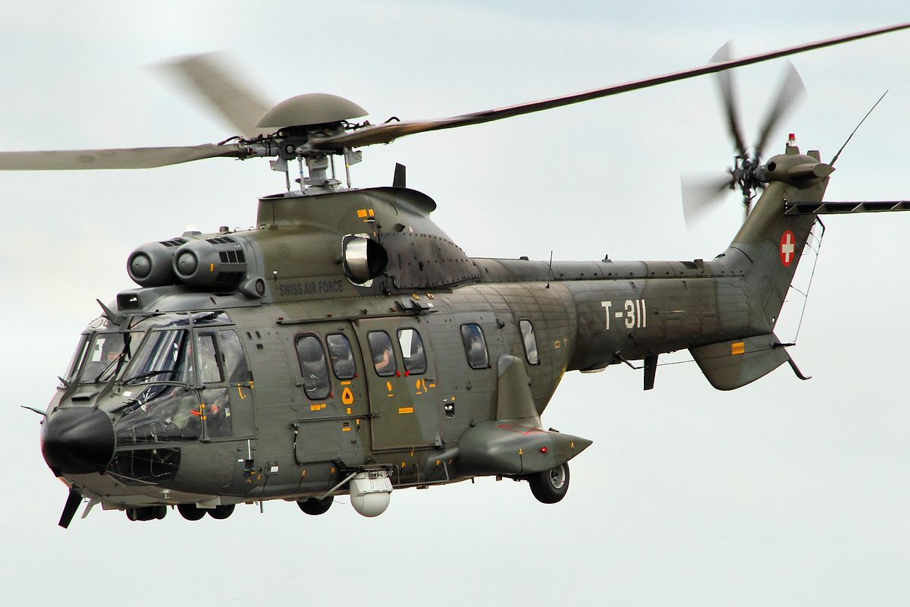
Clasification of air vehicles
Aerodynes with powerplant
Fixed-wing
Lift generated by dynamic pressure over the wings caused by forward movement.
Rotorcraft
Lift generated by dynamic pressure over the rotatory wings caused by rotation.
C2 - Confidential
Notes:
Aerodynes with powerplant include fixed-wing aircraft and rotorcraft and are heavier-than-the-air aircraft. The first group is the one nowadays know as airplanes (also known simply as aircraft). Rotorcraft include helicopters or autogyros (Invented by the Spanish engineer Juan de la Cierva in 1923).
Aerodynes with fixed-wing and provided with a power plant are known as airplanes. In a fixed-wing aircraft the lift forces are generated by the action air movements. The propulsion system is the responsible for the creation of the thrust that allows the creation of the movement relative to the air. Depending on the environment in which they perform the landing or takeoffs are airplanes and seaplanes.
A rotorcraft (or rotary wing aircraft) is a heavier-than-air aircraft that uses lift generated by wings, called rotor blades, that revolve around a mast. Several rotor blades mounted to a single mast are referred to as a rotor. The International Civil Aviation Organization (ICAO) defines a rotorcraft as supported in flight by the reactions of the air on one or more rotors.

Slide 7
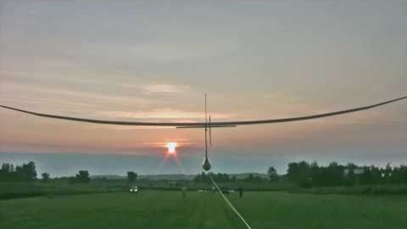
Clasification of air vehicles
Other aerodynes
Flapping wings
Imitate the flapping of birds, bats and insects.
C2 - Confidential
Notes:
An ornithopter is an aircraft that flies by flapping its wings. Designers seek to imitate the flapping-wing flight of birds, bats, and insects. Though machines may differ in form, they are usually built on the same scale as these flying creatures. Manned ornithopters have also been built, and some have been successful.

Slide 8
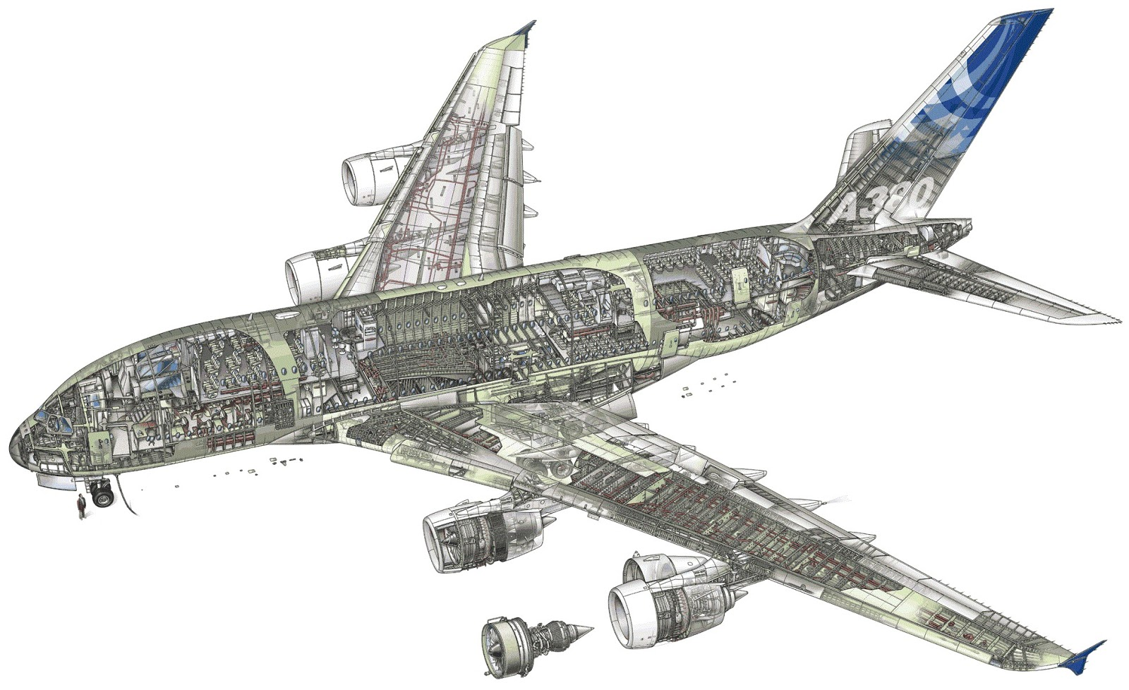
Airplanes. General Description
Vertical Tailplane
Fuselage
Cockpit
Horizontal Tailplane
Nose Landing Gear
Powerplant
Wing
C2 - Confidential
Notes:
Aerodynes with fixed-wing and provided with a power plant are known as airplanes.
The configuration of the aircraft depends on the aerodynamic properties to fly in a determined regime (low subsonic, high subsonic, supersonic).
In fact, the general configuration of the aircraft depends upon the layout of the wing, the fuselage, stabilizers, and power plant. This four elements, which are enough to distinguish, grosso modo, one configuration from another, are designed according to the aerodynamic properties.

Slide 9
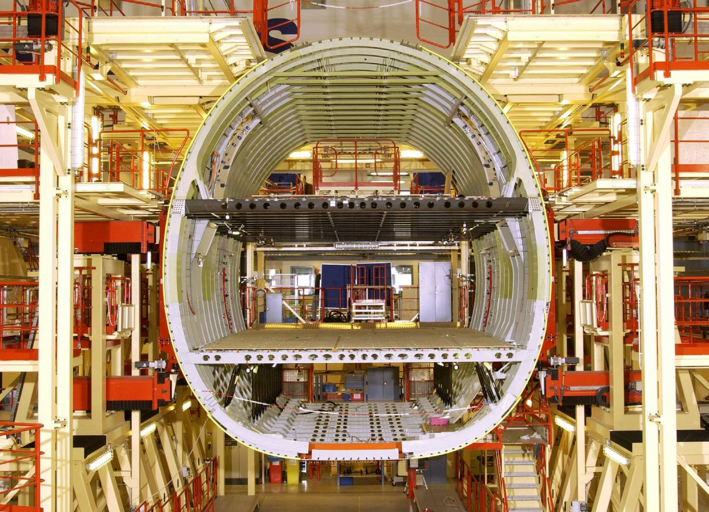
FUSELAGE
The fuselage can be design according to the mission of the aircraft:
Military Transport
Cargo Transport
Airlines
The functions of the fuselage are:
Holding and protect the payload
Having a cockpit for the crew
It is a central structure where all the others are connected.
Holding the equipment and avionics
C2 - Confidential
Notes:
The fuselage (from the French fuselé "spindle-shaped") is an aircraft's main body section. It holds crew, passengers, and cargo.
The fuselage can be design according to the mission of the aircraft:
Military Transport
Cargo Transport
Airlines
The functions of the fuselage are:
Holding and protect the payload
Having a cockpit for the crew
It is a central structure where all the others are connected.
Holding the equipment and avionics

Slide 10
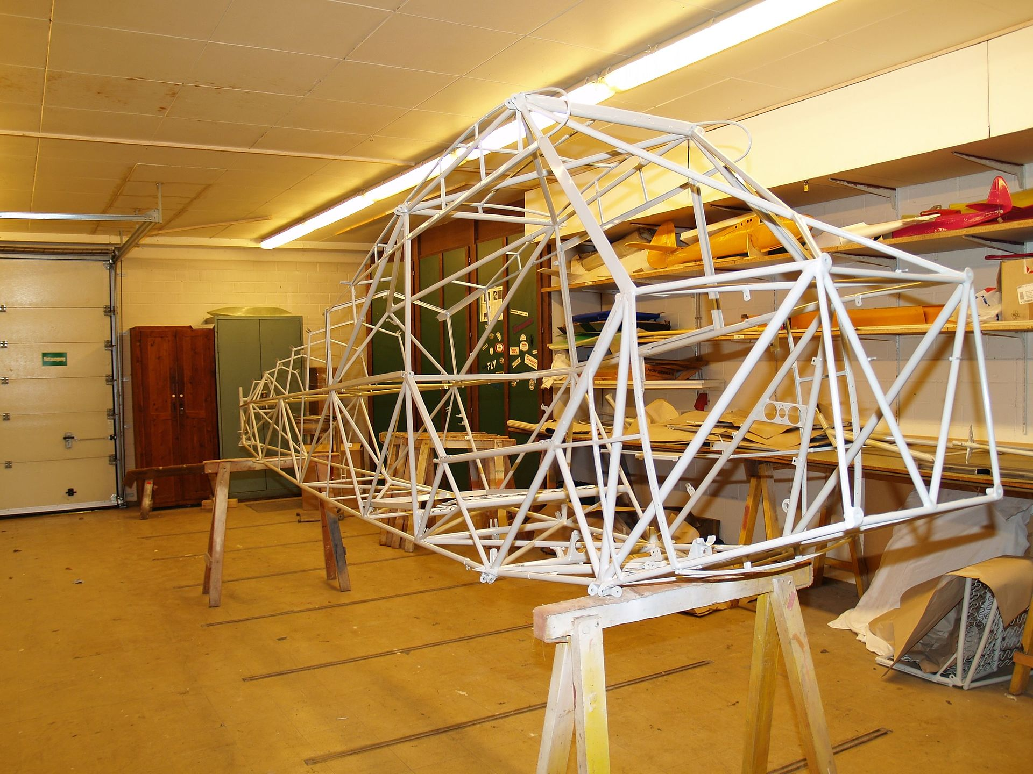
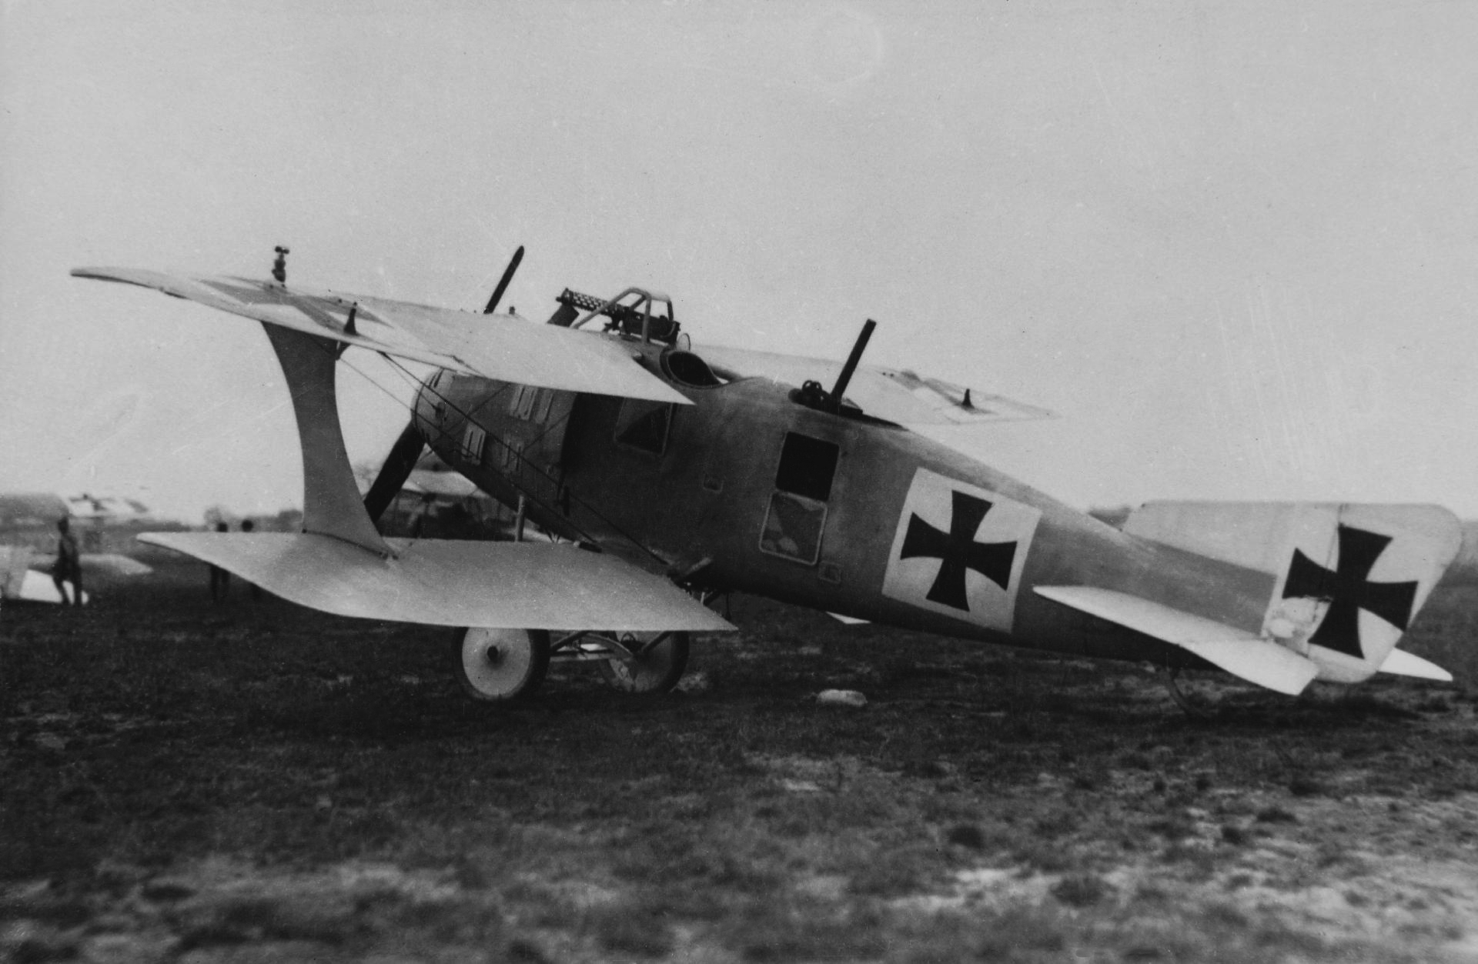
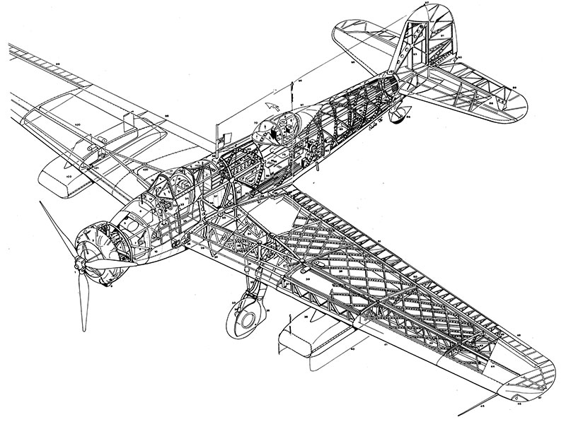
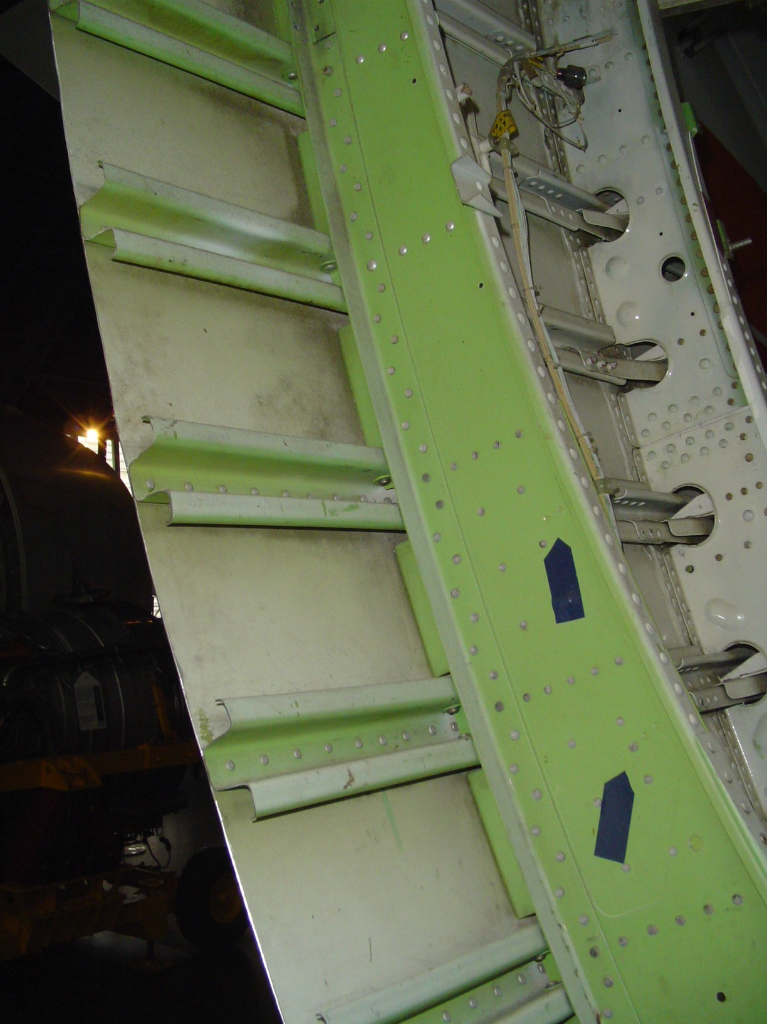
Fuselage. Structural Design
Typologies
Truss
Internal structure bears the load.
Monocoque shell
The external skin is the primary structure
Geodesic
Like truss but with aerodynamic shape
Semi-monocoque
Rigidized external skin
C2 - Confidential
Notes:
A truss is a rigid framework made up of members, such as beams, struts, and bars to resist deformation by applied loads. The truss-framed fuselage is generally covered with fabric. The truss-type fuselage frame is usually constructed of steel tubing welded together in such a manner that all members of the truss can carry both tension and compression loads. In some aircraft, principally the light, single engine models, truss fuselage frames may be constructed of aluminum alloy and may be riveted or bolted into one piece, with cross-bracing achieved by using solid rods or tubes.
A geodesic airframe is a type of construction for the airframes of aircraft developed by British aeronautical engineer Barnes Wallis in the 1930s (who sometimes spelled it "geodetic"). A geodetic (or geodesic) airframe makes use of a space frame formed from a spirally crossing basket-weave of load-bearing members. By having the geodesic curves form two helices at right angles to one another, the members became mutually supporting in a manner that the torsional load on each cancels out that on the other. In addition to being comparatively light and strong, the fact that the geodetic structure was all in the outer part of the airframe meant that the centre was a large empty space, ready to take payload or fuel.
Monocoque also called structural skin, is a structural system in which loads are supported by an object's external skin, like an eggshell. The word monocoque is a term for "single shell" or (of boats) "single hull". The true monocoque construction uses formers, frame assemblies, and bulkheads to give shape to the fuselage. The heaviest of these structural members are located at intervals to carry concentrated loads and at points where fittings are used to attach other units such as wings, powerplants, and stabilizers. Since no other bracing members are present, the skin must carry the primary stresses and keep the fuselage rigid. Thus, the biggest problem involved in monocoque construction is maintaining enough strength while keeping the weight within allowable limits.
The term semi-monocoque refers to a stressed shell structure that is like a true monocoque, but which derives at least some of its strength from conventional reinforcement. Semi-monocoque construction is used for, among other things, aircraft fuselages, car bodies and motorcycle frames. It was developed to overcome the strength/weight problem of monocoque construction. It also consists of frame assemblies, bulkheads, and formers as used in the monocoque design but, additionally, the skin is reinforced by longitudinal members called longerons. Longerons usually extend across several frame members and help the skin support primary bending loads. They are typically made of aluminum alloy either of a single piece or a built-up construction. Stringers are also used in the semi-monocoque fuselage. These longitudinal members are typically more numerous and lighter in weight than the longerons. They come in a variety of shapes and are usually made from single piece aluminum alloy extrusions or formed aluminum. Stringers have some rigidity but are chiefly used for giving shape and for attachment of the skin. Stringers and longerons together prevent tension and compression from bending the fuselage.

Slide 11
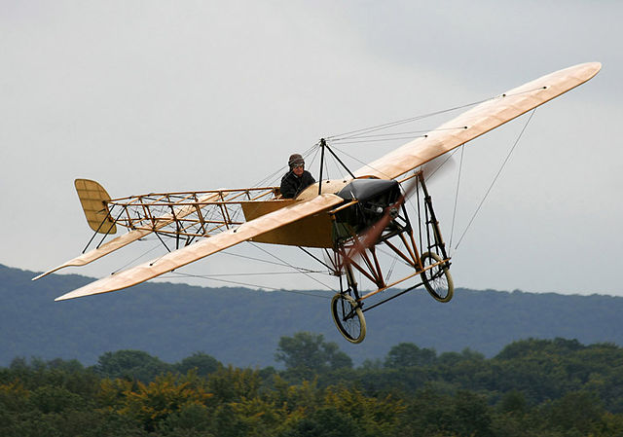
TRUSS
Advantages:
Simple to build.
Very high specific resistance.
Drawbacks:
- Lack of streamlined shape.
- Less internal space available.
It is mainly used in very light, single engine designs.
C2 - Confidential
Notes:
The main drawback of truss structure is its lack of a streamlined shape. In this construction method, lengths of tubing, called longerons, are welded in place to form a well braced framework. Vertical and horizontal struts are welded to the longerons and give the structure a square or rectangular shape when viewed from the end. Additional struts are needed to resist stress that can come from any direction. Stringers and bulkheads, or formers, are added to shape the fuselage and support the covering.
As technology progressed, aircraft designers began to enclose the truss members to streamline the airplane and improve performance. This was originally accomplished with cloth fabric, which eventually gave way to lightweight metals such as aluminum. In some cases, the outside skin can support all or a major portion of the flight loads. Most modern aircraft use a form of this stressed skin structure known as monocoque or semi-monocoque construction.

Slide 12
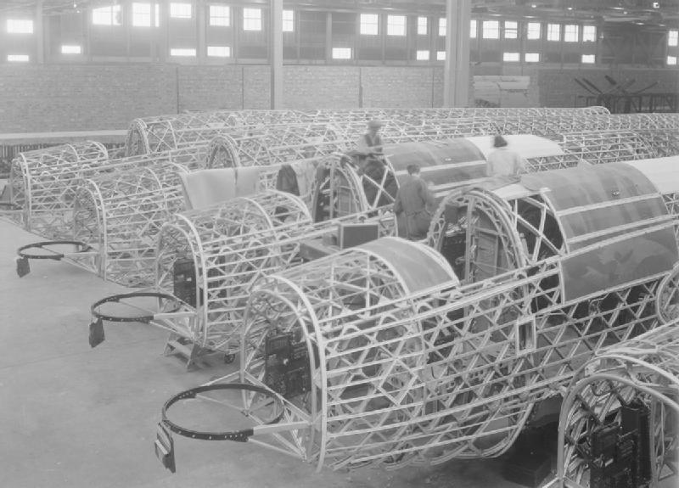
GEODESIC
Advantages:
The structure could be load bearing after extensive damage
Very high resistance.
Drawbacks:
Difficult to modify or adapt external shape
When external skin is made of the same material as the structure, it offers no advantage.
Used in airships and WWII era bombers for its strength.
C2 - Confidential
Notes:
The earliest-known use of a geodesic airframe design for any aircraft was for the pre-World War I Schütte-Lanz SL1 rigid airship's envelope structure of 1911, with the airship capable of up to a 38.3 km/h (23.8 mph) top airspeed. The Latécoère 6 was a French four-engined biplane bomber of the early 1920s. It was of advanced all-metal construction and probably the first aircraft to use geodetic construction. The system was later used by Wallis's employer, Vickers-Armstrongs in a series of bomber aircraft, the Wellesley, Wellington, Warwick and Windsor. In these aircraft, the fuselage was built up from several duralumin alloy channel-beams that were formed into a large framework. Wooden battens were screwed onto the metal, to which the doped linen skin of the aircraft was fixed.
The metal lattice-work gave a light structure with tremendous strength; any one of the stringers could support some of the load from the opposite side of the aircraft. Blowing out the structure from one side would still leave the load-bearing structure intact. As a result, Wellingtons with huge areas of framework missing continued to return home when other types would not have survived; the dramatic effect enhanced by the doped fabric skin burning off, leaving the naked frames exposed. The benefits of the geodesic construction were partly offset by the difficulty of modifying the physical structure of the aircraft to allow for a change in length, profile, wingspan etc.

Slide 13
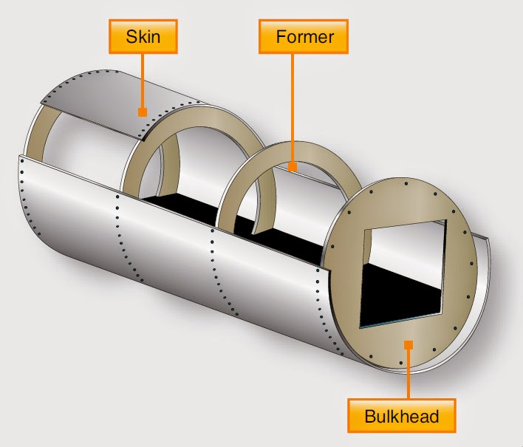
Monocoque
Advantages:
Improved strength and weight.
Provide and aerodynamic shape.
Drawbacks:
Difficult and expensive to manufacture.
Not tolerant to skin deformation.
Mainly replaced by semi-monocoque
C2 - Confidential
Notes:
Early aircraft were constructed using frames, typically of wood or steel tubing, which could then be covered (or skinned) with fabric such as Irish linen or cotton. The fabric made a minor structural contribution in tension but none in compression and was there for aerodynamic reasons only. By considering the structure as a whole and not just the sum of its parts, monocoque construction integrated the skin and frame into a single load-bearing shell with significant improvements to strength and weight.
The true monocoque construction uses formers, frame assemblies, and bulkheads to give shape to the fuselage. The heaviest of these structural members are located at intervals to carry concentrated loads and at points where fittings are used to attach other units such as wings, powerplants, and stabilizers. Since no other bracing members are present, the skin must carry the primary stresses and keep the fuselage rigid. Thus, the biggest problem involved in monocoque construction is maintaining enough strength while keeping the weight within allowable limits.

Slide 14
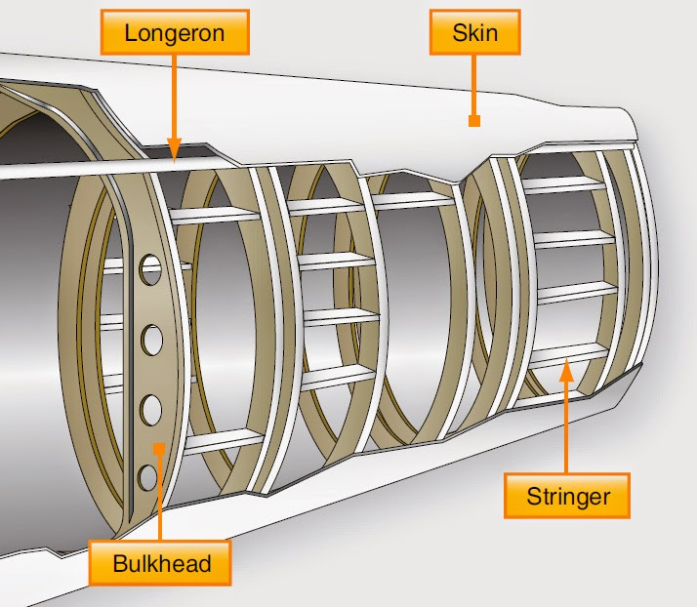
SEMI-MONOCOQUE
Advantages:
Better weight and resistance than monocoque.
Tolerant to damage and deformation.
Drawbacks:
Difficult and expensive to manufacture.
Used in most modern airplanes.
C2 - Confidential
Notes:
To overcome the strength/weight problem of monocoque construction, a modification called semimonocoque construction was developed. It also consists of frame assemblies, bulkheads, and formers as used in the monocoque design but, additionally, the skin is reinforced by longitudinal members called longerons. Longerons usually extend across several frame members and help the skin support primary bending loads. They are typically made of aluminum alloy either of a single piece or a built-up construction. Stringers are also used in the semi monocoque fuselage. These longitudinal members are typically more numerous and lighter in weight than the longerons. They come in a variety of shapes and are usually made from single piece aluminum alloy extrusions or formed aluminum. Stringers have some rigidity but are chiefly used for giving shape and for attachment of the skin. Stringers and longerons together prevent tension and compression from bending the fuselage.
The semi monocoque fuselage is constructed primarily of alloys of aluminum and magnesium, although steel and titanium are sometimes found in areas of high temperatures. Individually, no one of the components is strong enough to carry the loads imposed during flight and landing. But, when combined, those components form a strong, rigid framework. This is accomplished with gussets, rivets, nuts and bolts, screws, and even friction stir welding. A gusset is a type of connection bracket that adds strength.
To summarize, in semi monocoque fuselages, the strong, heavy longerons hold the bulkheads and formers, and these, in turn, hold the stringers, braces, web members, etc. All are designed to be attached together and to the skin to achieve the full-strength benefits of semi monocoque design. It is important to recognize that the metal skin or covering carries part of the load. The fuselage skin thickness can vary with the load carried and the stresses sustained at a particular location. The advantages of the semi monocoque fuselage are many. The bulkheads, frames, stringers, and longerons facilitate the design and construction of a streamlined fuselage that is both rigid and strong. Spreading loads among these structures and the skin means no single piece is failure critical. This means that a semi monocoque fuselage, because of its stressed-skin construction, may withstand considerable damage and still be strong enough to hold together.

Slide 15
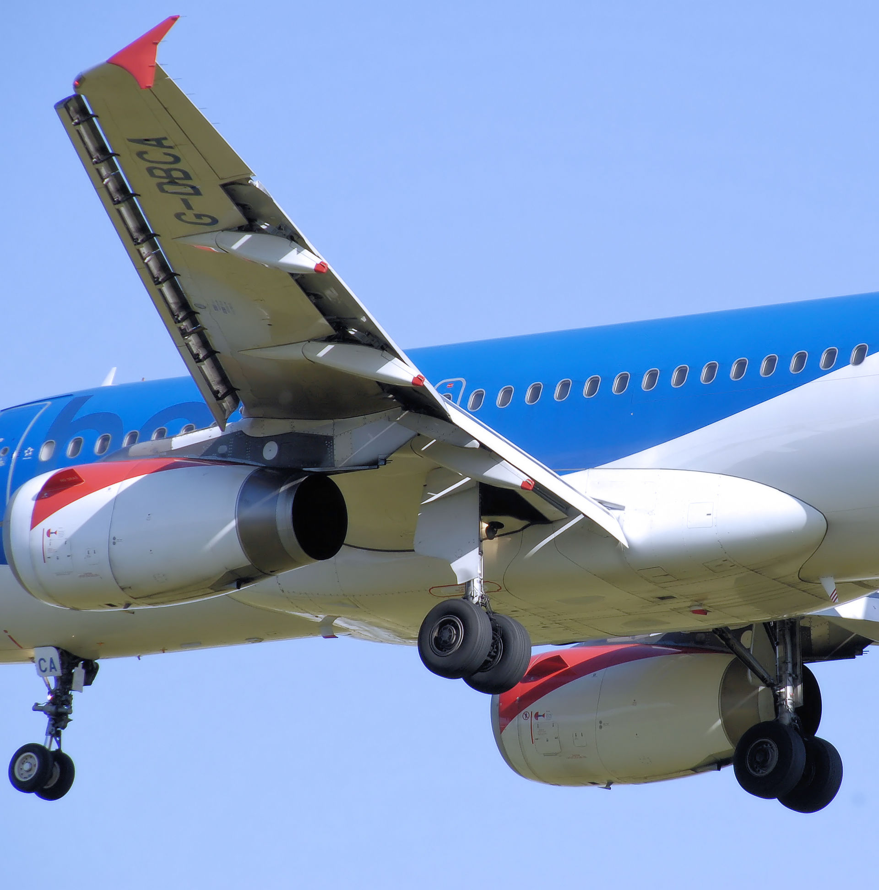
WING
Produces lift with the least amount of drag. The main design characteristics are:
Wing shape.
Vertical position with respect to the fuselage.
Longitudinal position determined by the centering.
Wing-fuselage fairings to improve the airplane aerodynamics.
C2 - Confidential
Notes:
A wing is a type of fin that produces lift, while moving through air or some other fluid. As such, wings have streamlined cross-sections that are subject to aerodynamic forces and act as airfoils. A wing's aerodynamic efficiency is expressed as its lift-to-drag ratio. The lift a wing generates at a given speed and angle of attack can be one to two orders of magnitude greater than the total drag on the wing. A high lift-to-drag ratio requires a significantly smaller thrust to propel the wings through the air at sufficient lift. The selection of the configuration of the wing goes a lot depending on the requirements of operation. The aspects related to the different characteristics structural needs and aerodynamics can be decisive factors when choosing an initial setup. The final decision must be subject to maximizing the flexibility of operation of the final design.

Slide 16
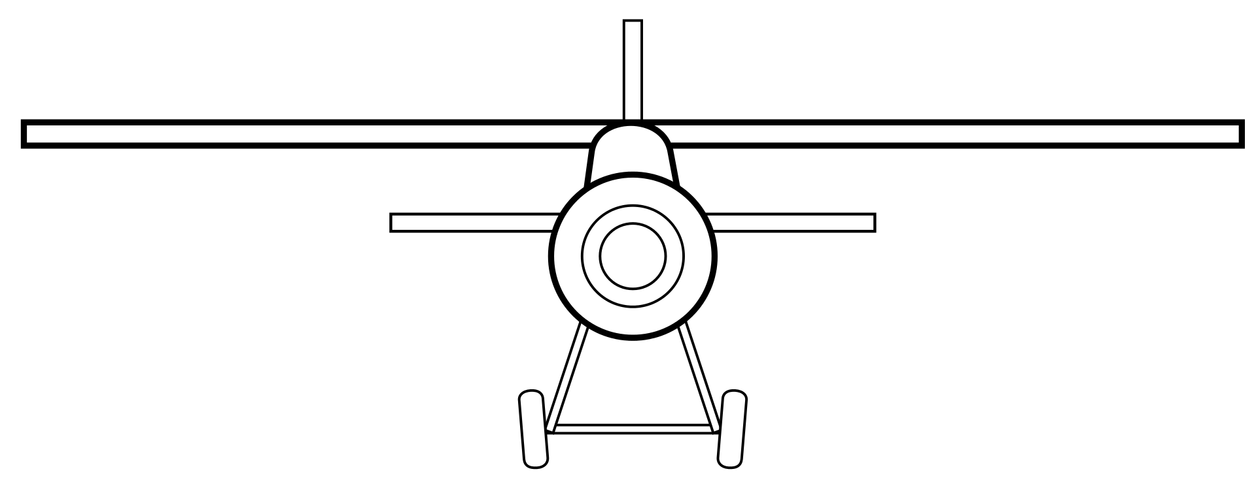
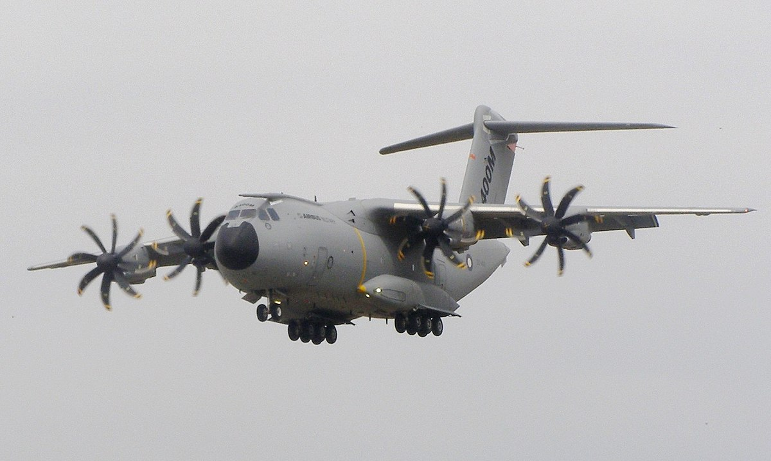
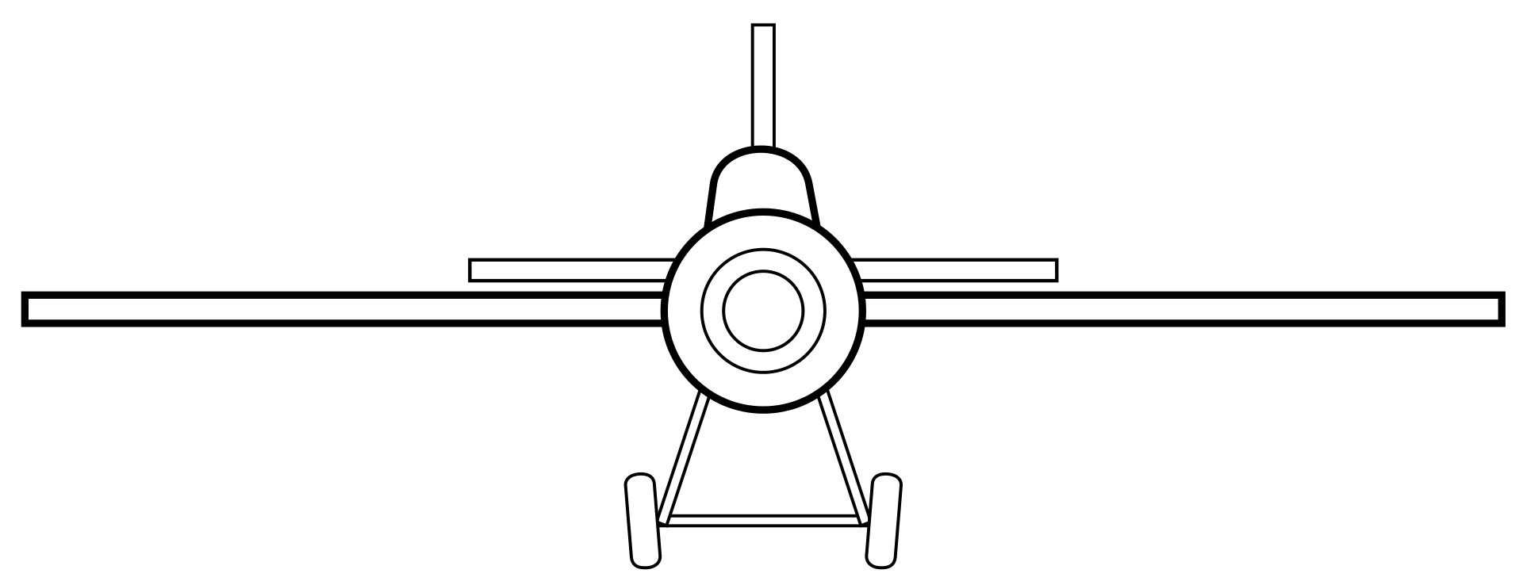
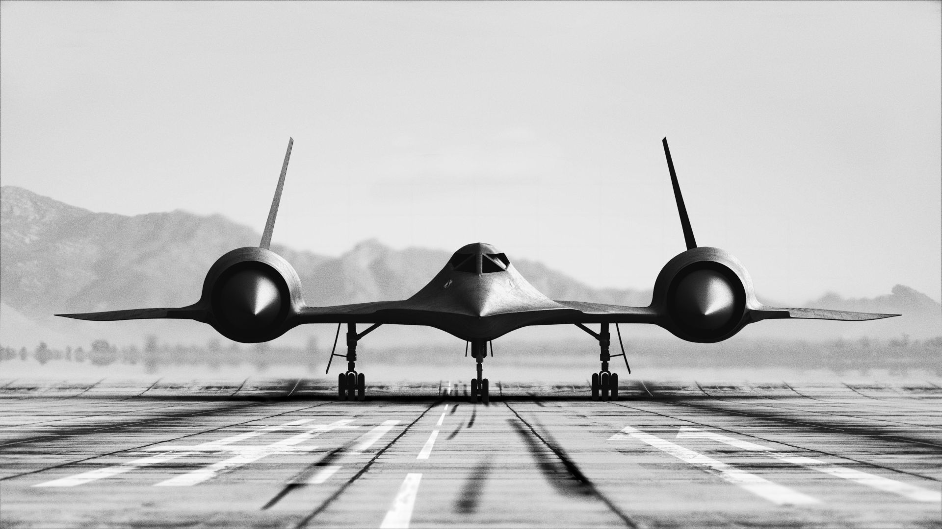
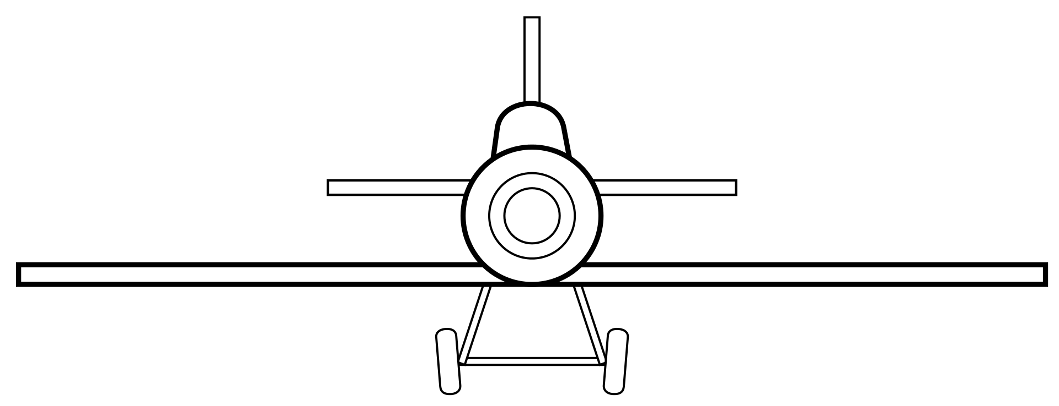
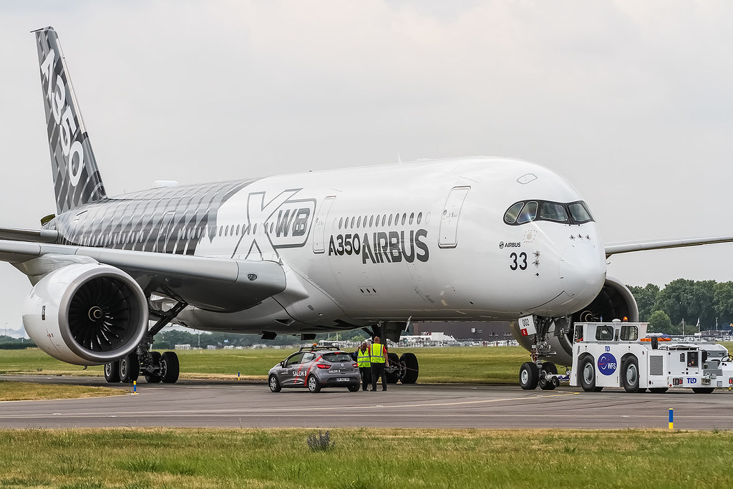
WINGS POSITION Relative to fuselage
High Wing
Mid Wing
Low Wing
C2 - Confidential
Notes:
The wing vertical location with respect to the fuselage is generally set by the real-world environment in which the aircraft will operate. For example, virtually all high-speed commercial transport aircraft are of low-wing de-
sign, yet military transport aircraft designed to similar mission profiles and payload weights are all of high-wing design.

Slide 17
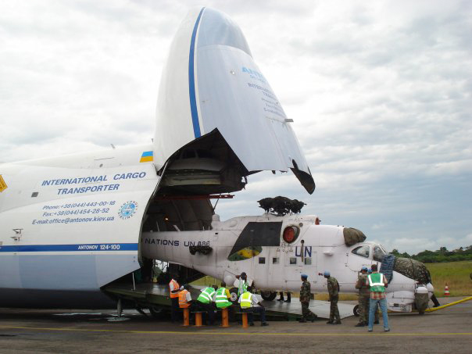
High Wing
Used mainly in military transport:
Easy loading/unloading operations.
Stronger floor.
Also used for braced-wing configurations.
Prevents ground effect.
C2 - Confidential
Notes:
High Wing:
The major benefit of a high wing is that it allows placing the fuselage closer to the ground. For military transport aircraft such as the C-5 and C-141, this allows loading and unloading the cargo without special ground handling gear. In fact, these aircraft place the floor of the cargo compartment about 4-5 ft off the ground, which is the height of the cargo area of most trucks. If cargo is needed at a remote field lacking ground-handling gear, the trucks can be backed right up to the aircraft for loading.
With a high wing, jet engines or propellers will have sufficient ground clearance without excessive landing-gear length. Also, the wing tips of a swept high wing are not as likely to strike the ground when in a nose-high, rolled attitude. For these reasons, landing-gear weight is generally reduced for a high-wing aircraft.
For an aircraft designed with short takeoff and landing (STOL) requirements, a high wing offers several advantages. The high position allows room for the very large wing flaps needed for a high lift coefficient. The height of
the wing above the ground tends to prevent "floating," where the ground effect increases lift as the aircraft approaches the ground. A floating tendency makes it difficult to touch down on the desired spot. Finally, most STOL designs are also intended to operate from unimproved fields. A high wing places the engines and propellers away from flying rocks and debris.

Slide 18
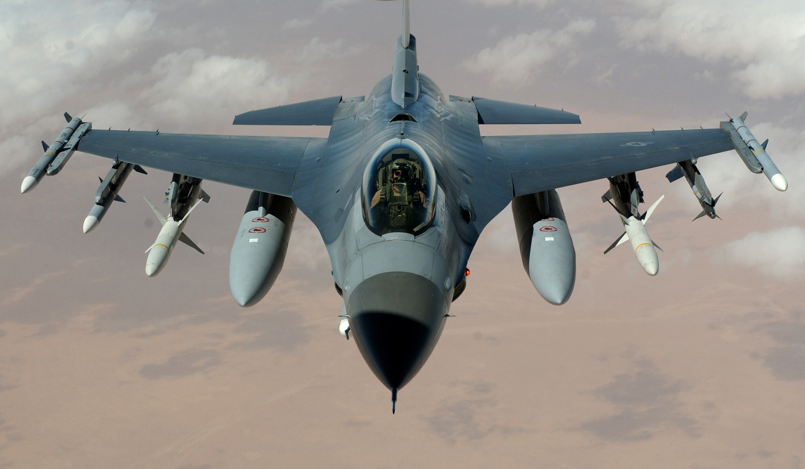
MID Wing
Used mainly in military combat planes:
Aerodynamically optimal
High Speed Flight
Minimizes interference between fuselage and wing at high Angles of Attack (AoA).
C2 - Confidential
Notes:
Mid Wing:
Mainly used in high performance military aircraft. The mid wing offers some of the ground clearance benefits of the high wing. Many fighter aircraft are mid-winged to allow bombs and missiles to be carried under the wing. A high-wing arrangement would restrict the pilot's visibility to the rear-the key to survival of a fighter in combat.
The mid-wing arrangement is probably superior for aerobatic maneuverability. The dihedral usually required for adequate handling qualities in a low-wing design in normal flight will act in the wrong direction during
inverted flight, making smooth aerobatic maneuvers difficult.

Slide 19
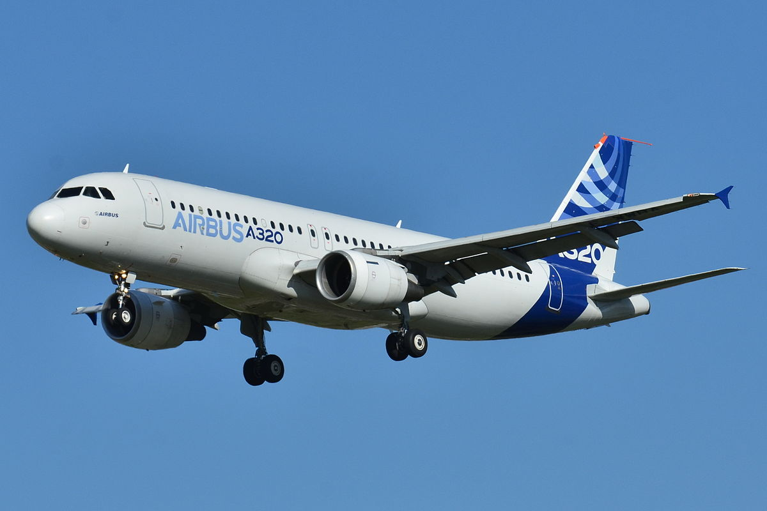
LOW Wing
Used in high-speed transports:
Easy landing gear storage.
Greater ground clearance.
Requires special equipment for loading and unloading.
C2 - Confidential
Notes:
Low Wing:
The major advantage of the low-wing approach comes in landing-gear stowage. With a low wing, the trunnion about which the gear is retracted can be attached directly to the wing box which, being strong already, will not need much extra strengthening to absorb the gear loads. When retracted, the gear can be stowed in the wing itself, in the wing-fuselage fairing, or in the nacelle. This eliminates the external blister usually used with the high-wing approach.

Slide 20
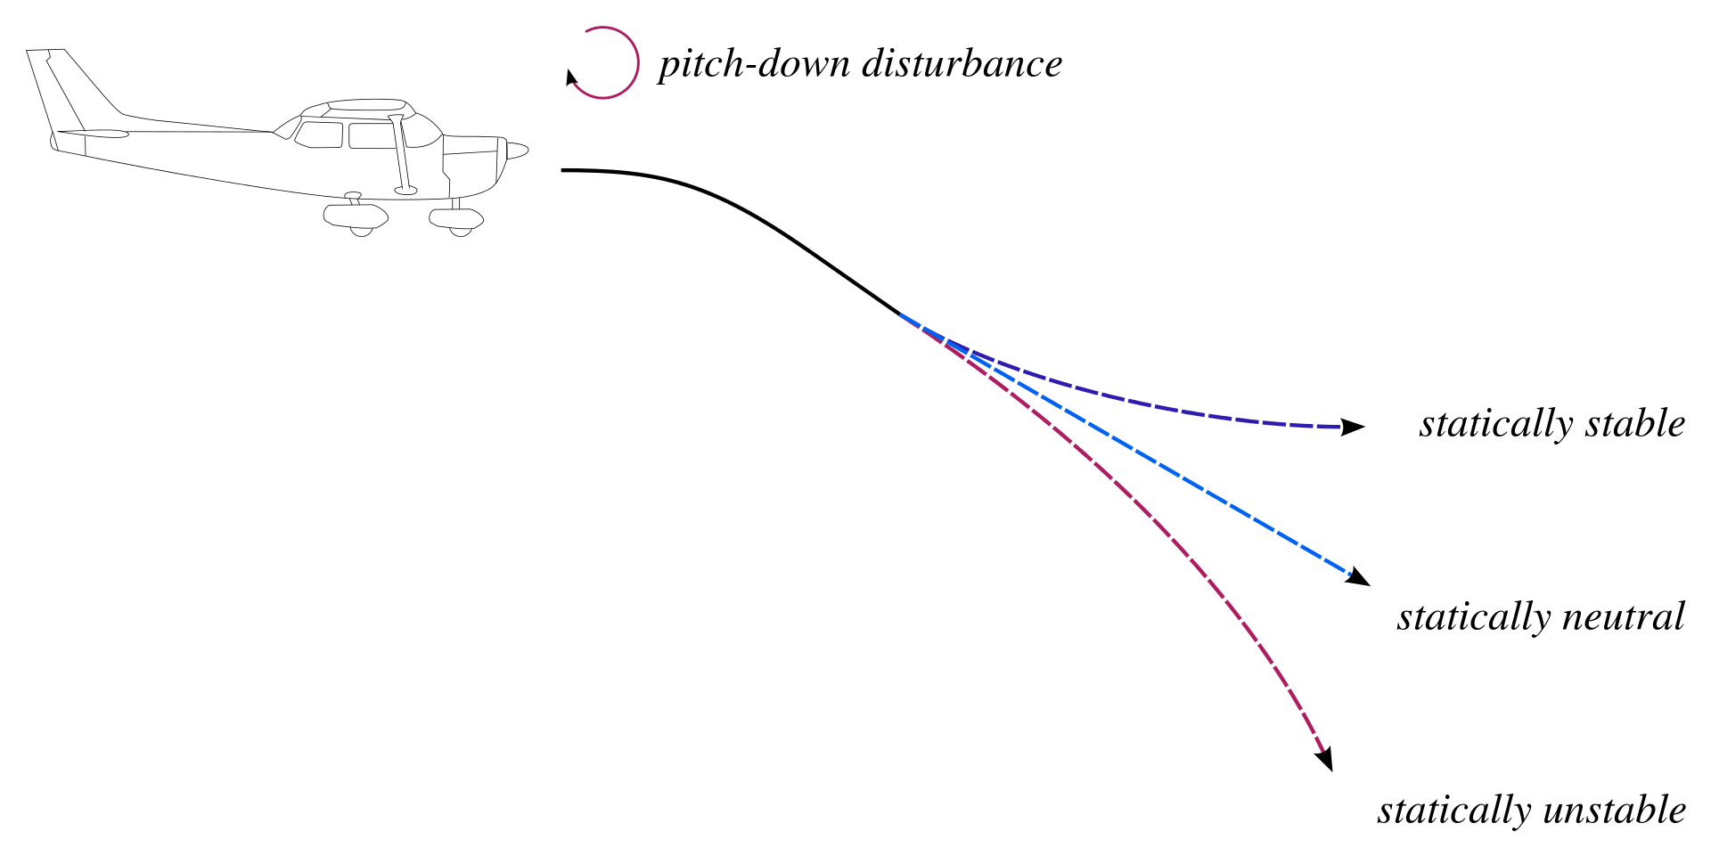
Tail Functions
The horizontal tailplane balances the forces created by the wing.
The vertical tailplane provides stability in case of engine failure.
Both the vertical and horizontal tailplane provide control.
C2 - Confidential
Notes:
Tails are little wings. Much of the previous discussion concerning wings can also be applied to tail surfaces. The major difference between a wing and a tail is that, while the wing is designed routinely to carry a substantial amount of lift, a tail is designed to operate normally at only a fraction of its lift potential. Any time in flight that a tail comes close to its maximum lift potential, and hence its stall angle, something is very wrong! Tails provide for trim, stability, and control. Trim refers to the generation of a lift force that, by acting through some tail moment arm about the center of gravity, balances some 0th.er moment produced by the aircraft.
For the horizontal tail, trim primarily refers to the balancing of the moment created by the wing. An aft horizontal tail typically has a negative incidence angle of about 2-3 deg to balance the wing pitching moment. As the wing pitching moment varies under different flight conditions, the horizontal tail incidence is usually adjustable through a range of about 3 deg up and down. For the vertical tail, the generation of a trim force is normally not required because the aircraft is usually left-right symmetric and does not create any unbalanced yawing moment. The vertical tail of a multi-engine aircraft must be capable of providing a sufficient trim force in the event of an engine failure.
The tails are also a key element of stability, acting much like the fins on an arrow. While it is possible to design a stable aircraft without tails, such a design is usually penalized in some other area, such as a compromised airfoil shape, excessive wing area or sweep, or narrow center-of-gravity range.
The other major function of the tail is control. The tail must be sized to provide adequate control power at all critical conditions. These critical conditions for the horizontal tail or canard typically include nosewheel liftoff, low-speed flight with flaps down, and transonic maneuvering. For the vertical tail, critical conditions typically include engine-out flight at low speeds, maximum roll rate, and spin recovery.

Slide 21
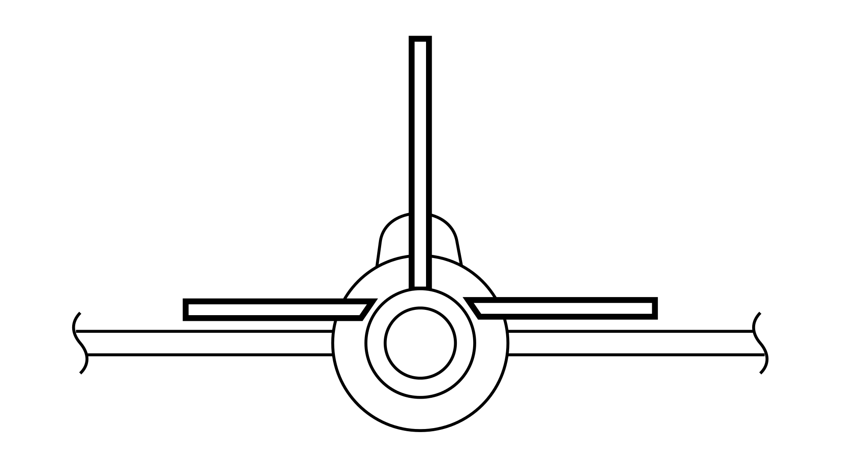
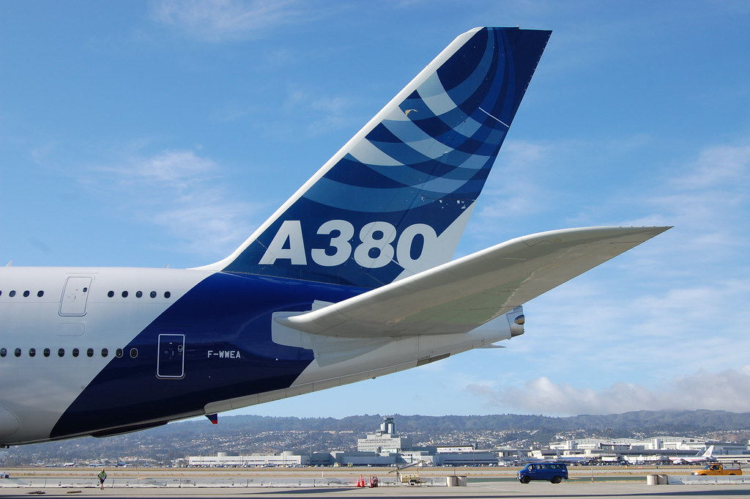
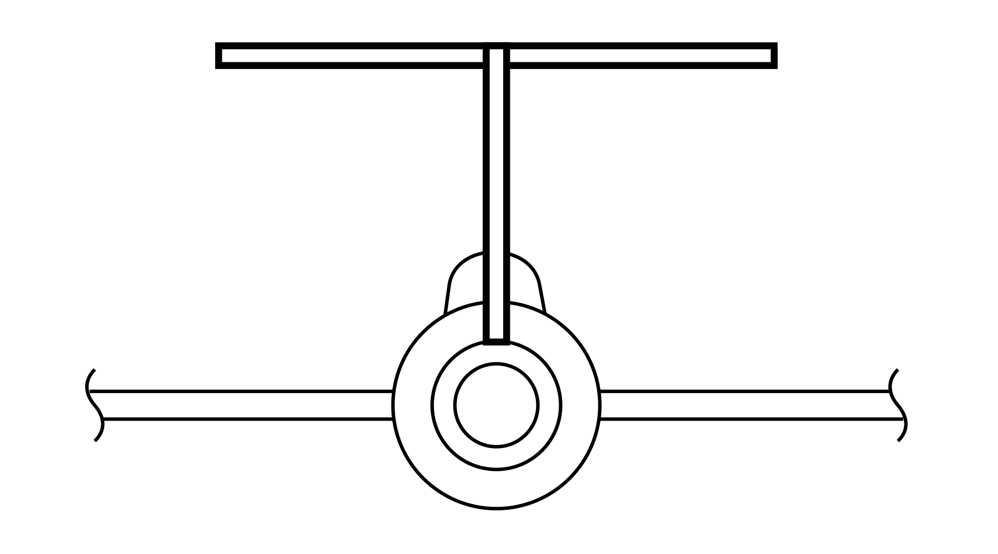
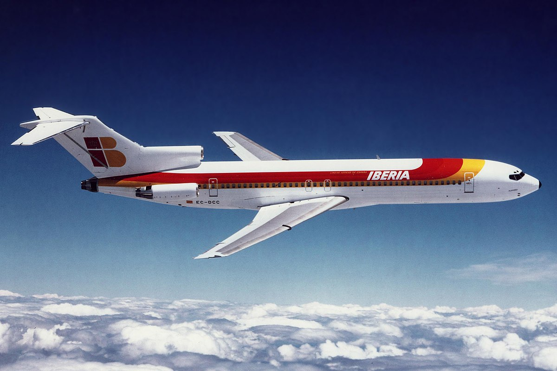
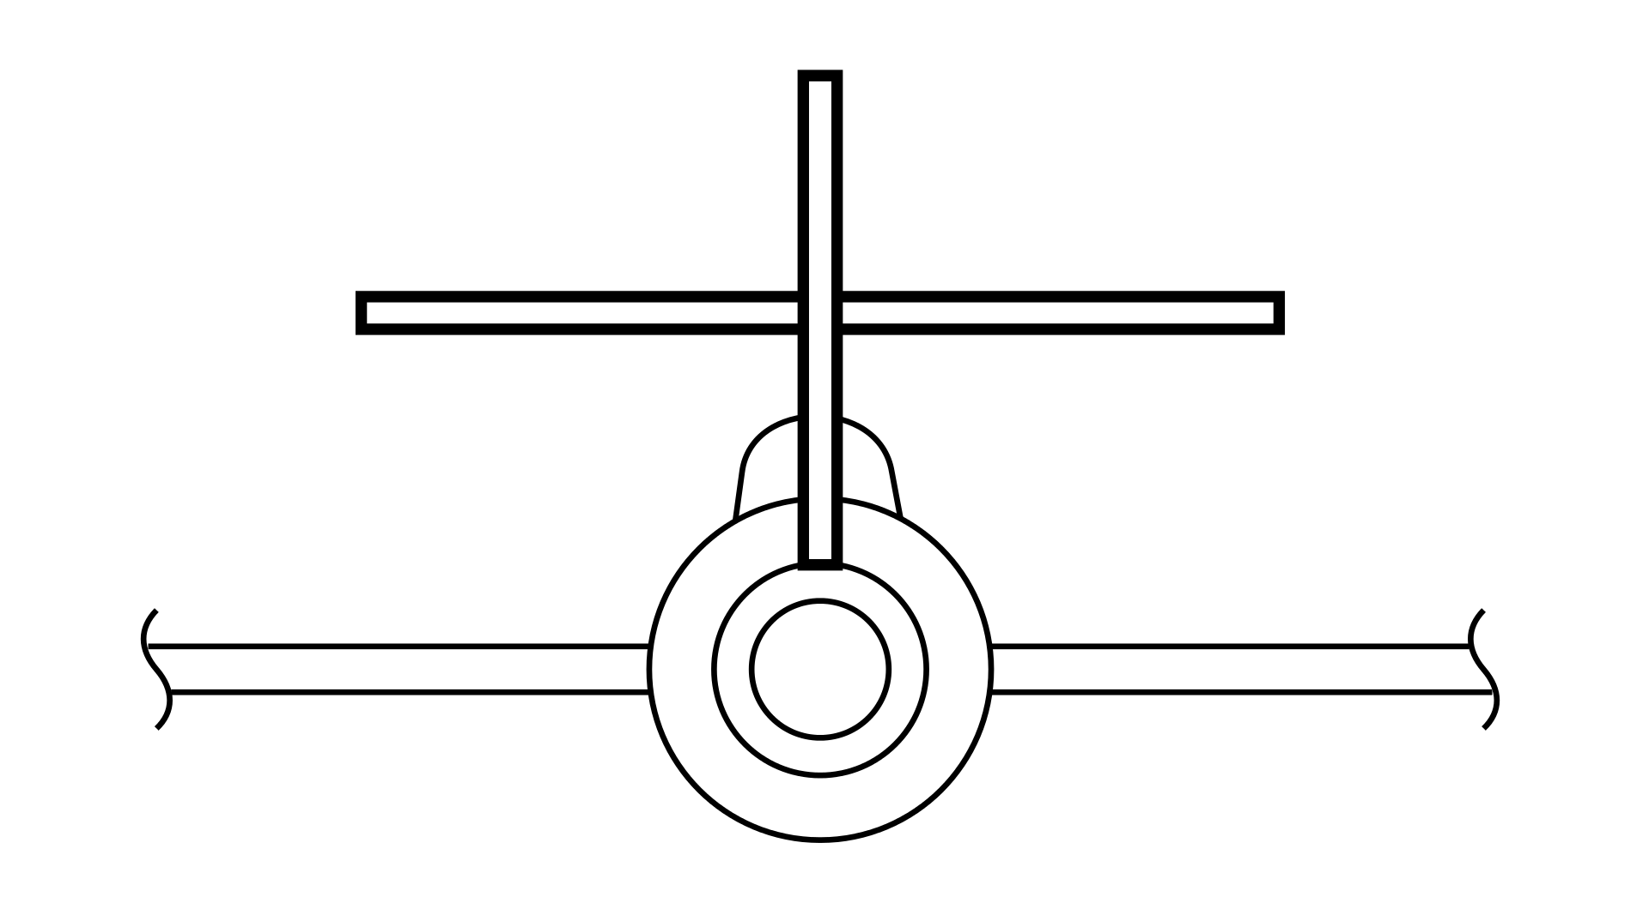
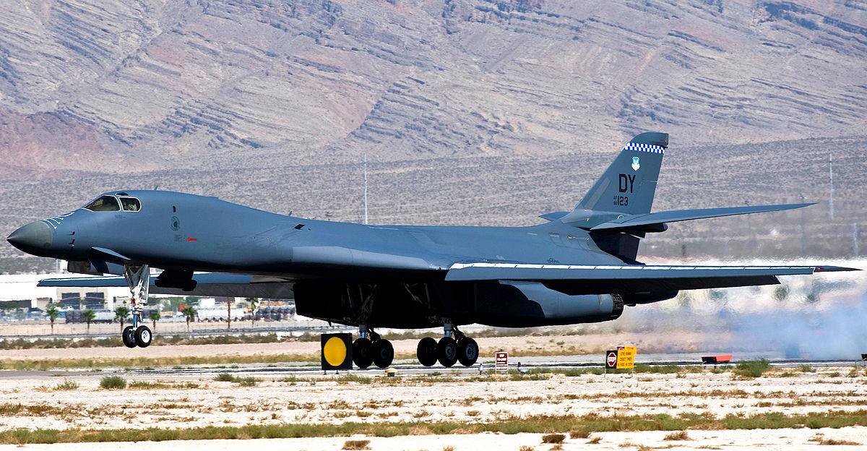
Empennage (tail) geometry
Conventional
T-Tail
Cruciform
C2 - Confidential
Notes:
The first shown has become "conventional" for the simple reason that it works. For most aircraft designs, the conventional tail will usually provide adequate stability and control at the lightest weight. Probably 70% or more of the aircraft in service have such a tail arrangement. However, there are many reasons for considering others. The "T-tail" is also widely used. A T-tail is inherently heavier than a conventional tail because the vertical tail must be strengthened to support the horizontal tail, but the T-tail provides compensating advantages in
many cases. Due to end-plate effect, the T-tail allows a smaller vertical tail. The T-tail lifts the horizontal tail clear of the wing wake and propwash, which makes it more efficient and hence allows reducing its size. This also reduces buffet
on the horizontal tail, which reduces fatigue for both the structure and the pilot. In jet transport aircraft such as the DC-9 and B-727, the T-tail allows the use of engines mounted in pods on the aft fuselage. Finally, the T-tail is
considered stylish, which is not a trivial consideration. The cruciform tail, a compromise between the conventional and T-tail arrangements, lifts the horizontal tail to avoid proximity to a jet exhaust (as on the B-1B), or to expose the lower part of the rudder to undisturbed air during high angle-of-attack conditions and spins. These goals can be accomplished with a T-tail, but the cruciform tail will impose less of a weight penalty. However, the cruciform tail will not provide a tail-area reduction due to endplate effect as will a T-tail.

Slide 22
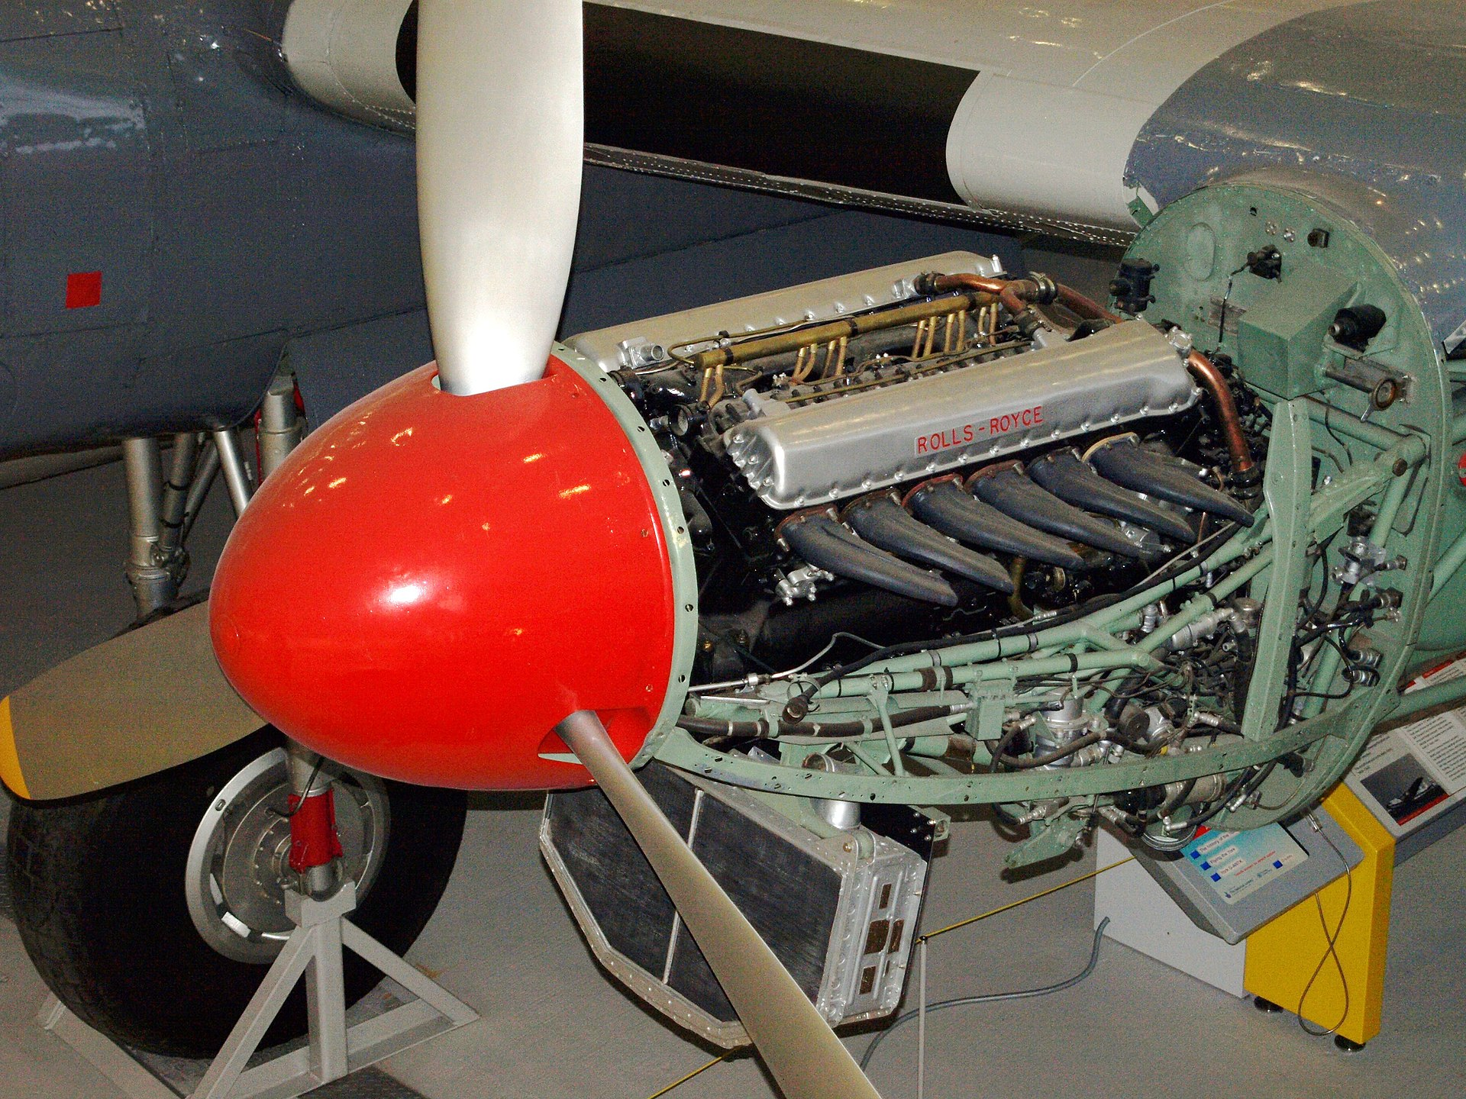
PowerplantS (i)
Piston Engine
Turboprop
High-Bypass Turbofans
C2 - Confidential
Notes:
All aircraft engines operate by compressing outside air, mixing it with fuel, burning the mixture, and extracting energy from the resulting high-pressure hot gases. In a piston-prop, these steps are done intermittently in the cylinders via the reciprocating pistons. In a turbine engine, these steps are done continuously, but in three distinct parts of the engine. The piston-prop was the first form of aircraft propulsion. By the dawn of the jet era, a 5500-hp piston-prop engine was in development. Today piston-props are mainly limited to light airplanes and some agricultural aircraft.
Piston-prop engines have two advantages. They are cheap, and they have the lowest fuel consumption. However, they are heavy and produce a lot of noise and vibration. Also, the propeller loses efficiency as the velocity increases.
The turbine engine consists of a "compressor," a "burner," and a "turbine." These separately perform the three functions of the reciprocating piston in a piston engine.
The turboprop and turbofan engines both use a turbine to extract mechanical power from the exhaust gases. This mechanical power is used to accelerate a larger mass of outside air, which increases efficiency at lower
Speeds. For the turboprop engine, the outside air is accelerated by a conventional propeller. The "prop-fan" or "unducted fan" is essentially a turboprop with an advanced aerodynamics propeller capable of near-sonic speeds. For the turbofan engine, the air is accelerated with a ducted fan of one or several stages.

Slide 23
PowerplantS (iI)
Low-bypass Turbofans
Turbojet
Scramjets
C2 - Confidential
Notes:
The wing vertical location with respect to the fuselage is generally set by the real-world environment in which the aircraft will operate. For example, virtually all high-speed commercial transport aircraft are of low-wing de-
sign, yet military transport aircraft designed to similar mission profiles and payload weights are all of high-wing design.

